Slide 1


INVESTMENT
KWAZULU-NATAL TOURISM
OPPORTUNITIES
2023/2024
ww w . zu l u . o r g . z a

Slide 2
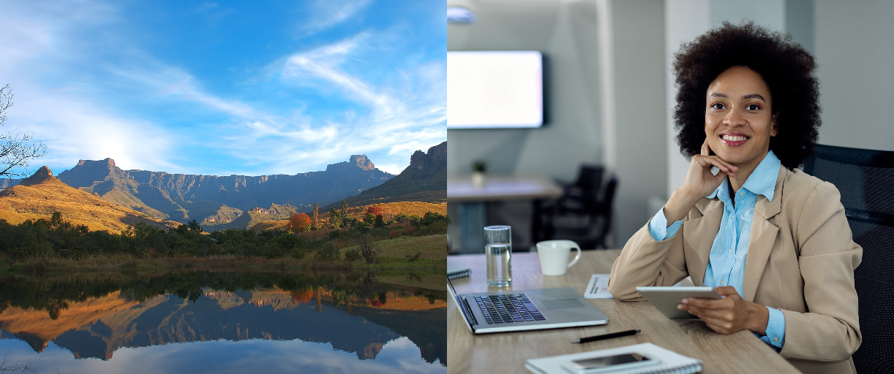

CONTENTS
Introduction 03
Shakaland Cultural & Avdenture Resort 04
Durban Eye Wheel Development 05
Amatata Mountain Tourism &
Cultural Centre 06
Woodstock Dam Resort Development 07
Balele Game Park 08
Kings Lodge 09
uMkomazi River Resort & Spa 10
Umgababa Coastal Resort 11
Reasons to Invest in KwaZulu-Natal 12

Slide 3
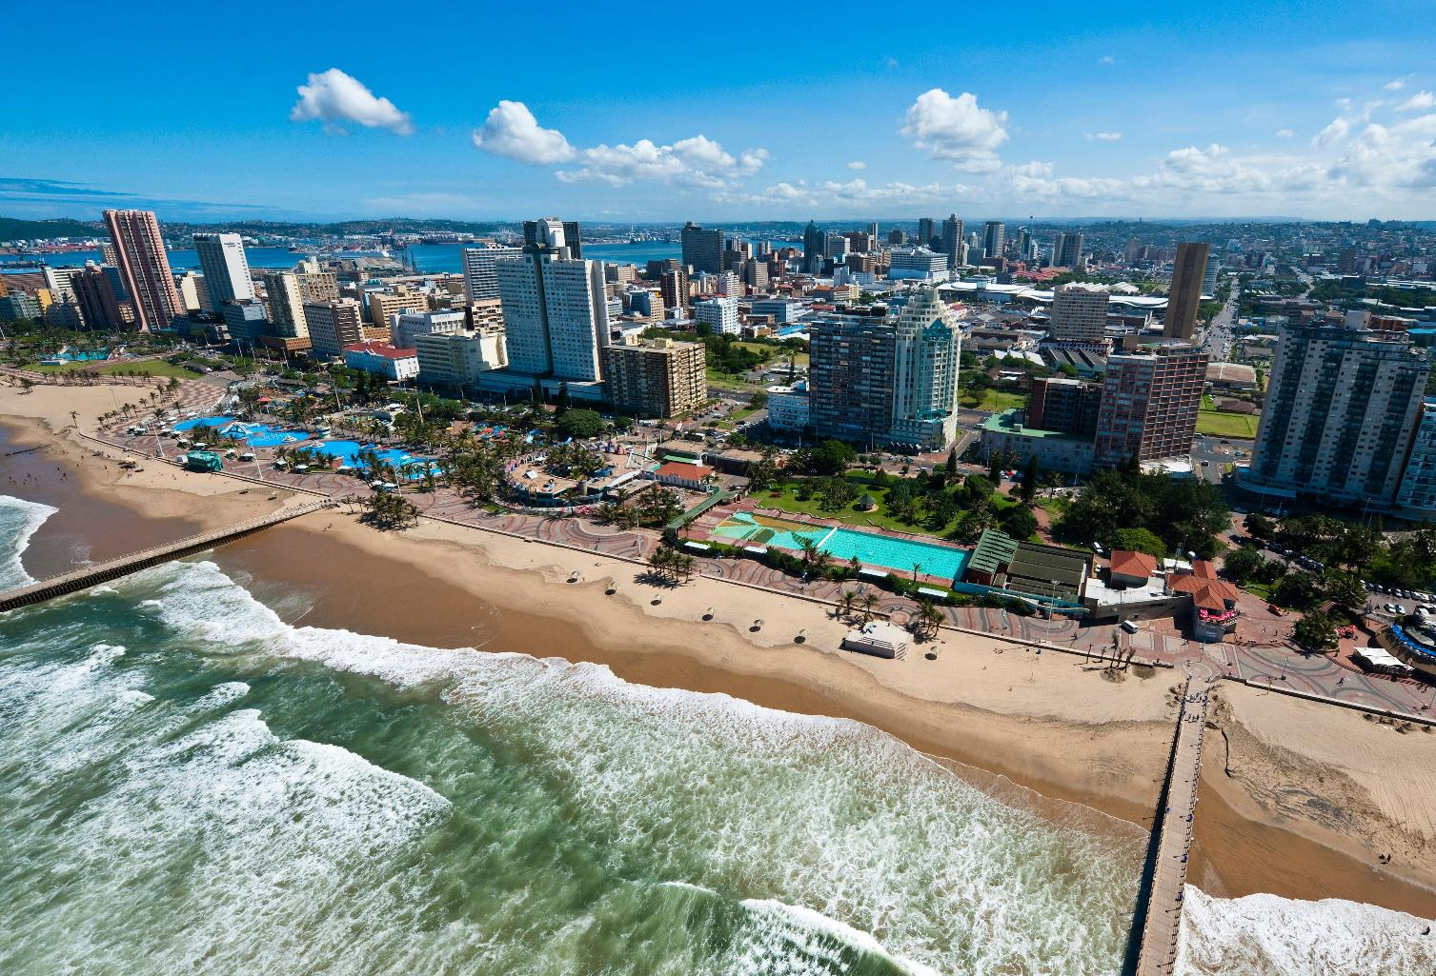
KWAZULU-NATAL... YOUR GATEWAY TO AFRICA
BOASTING THE SECOND LARGEST ECONOMY IN THE COUNTRY, KWAZULU-NATAL HAS A KEY COMPETITIVE ADVANTAGE OF UNMATCHED NATURAL RESOURCE ENDOWMENTS, EXCEPTIONAL PRODUCTIVE CAPACITY, WELL-DEVELOPED FIRST-WORLD INFRASTRUCTURE, NOT FORGETTING AN ADVANTAGEOUS COASTAL LOCATION, MAKING
KWAZULU-NATAL ONE OF THE MOST SOPHISTICATED EMERGING MARKETS IN THE WORLD.

Slide 4
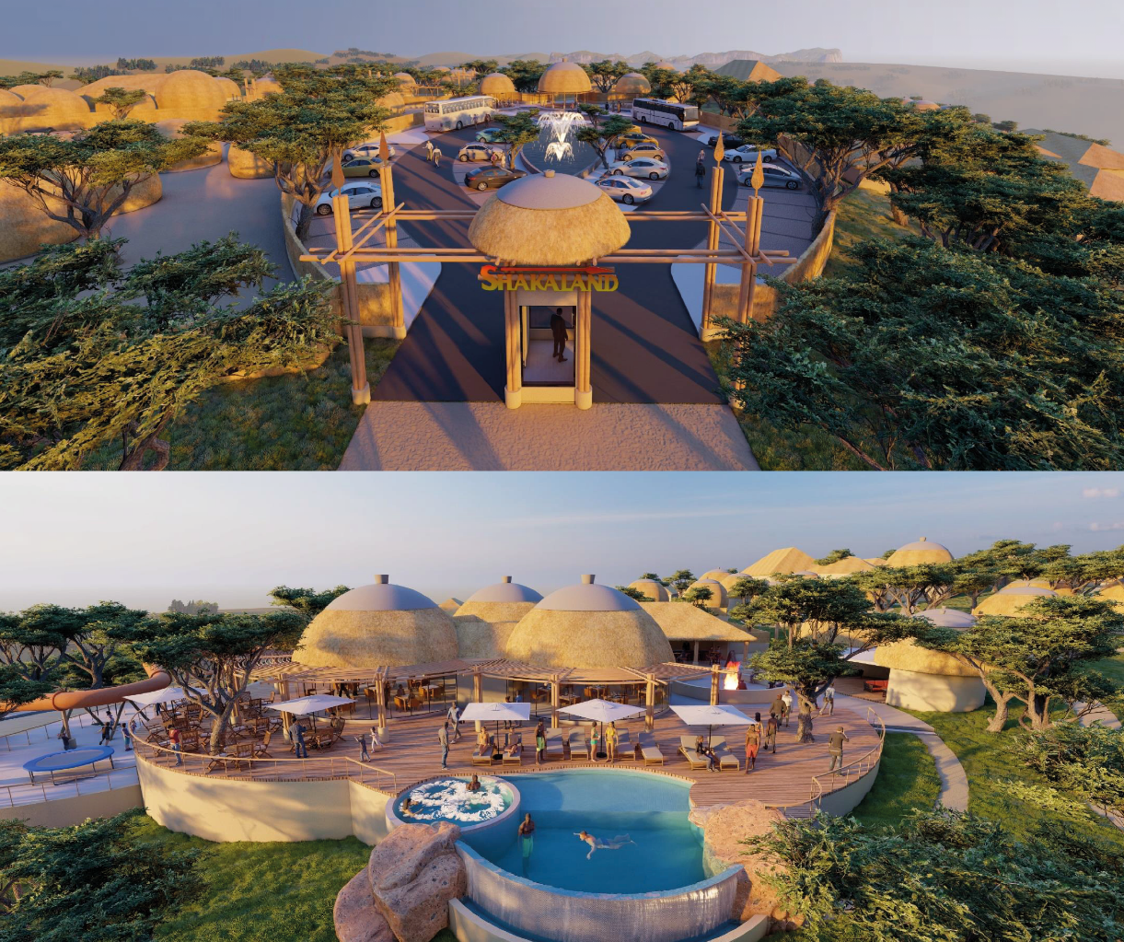
SHAKALAND CULTURAL & ADVENTURE RESORT
Description
Development and renovation of existing Shakaland Cultural & Adventure Resort. It offers tourists a unique opportunity of experiencing the rich Zulu cultural
heritage, adventure activities, nature-based activities and Wellness Centre.
The facility currently enjoys good bulk and municipal
services.
Location
The 67.68 ha site situated in the Nkwalini Valley, between Eshowe and Melmoth, nestling on the top of the Entembeni Hills and overlooking the picturesque Phobane Lake.
INVESTMENT VALUE
R75.4
MILLION
Nearby Towns/Cities
Eshowe
Richards Bay
Ulundi
Durban
Nearby Airport
King Shaka International Airport is 130km away
Richards Bay Airport 92,1km
Project Status
Market Feasibility
Business Plan
Municipal Approvals and Authorization
Land secured

Slide 5
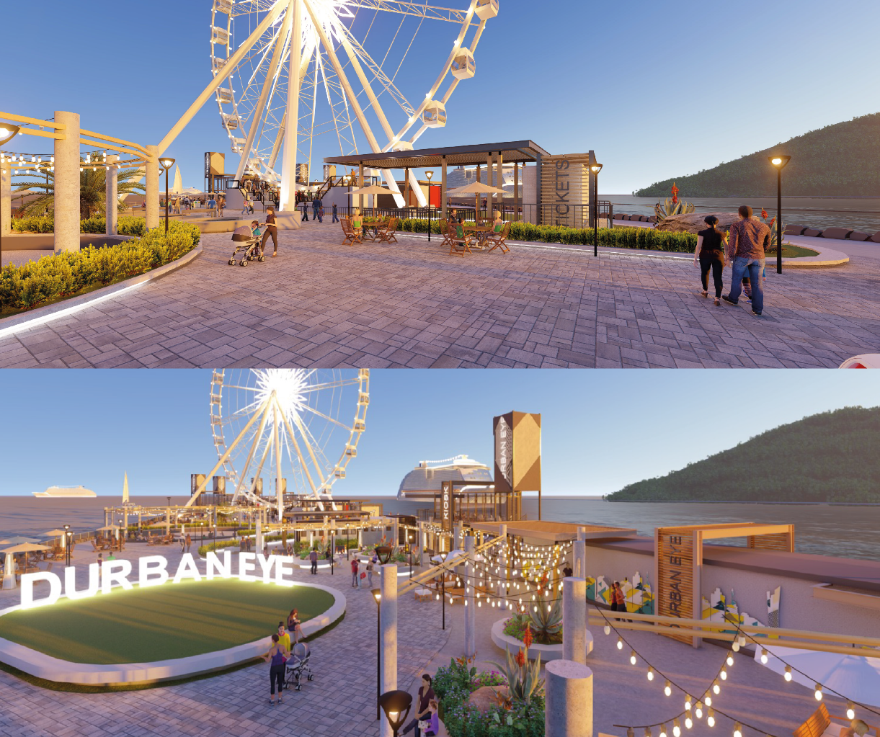
DURBAN EYE FERRIS WHEEL
Description
Establishment of a giant observation ferris wheel that will offer a spectacular 360-degree panoramic view of Durban City and the Indian Ocean..
Location
The site is situated in the Durban Beach Promenade, on the North Pier adjacent to the mouth of the Durban Harbour
Nearby Towns/Cities
Umhlanga
Ballito
Pietermaritzburg
Richards Bay
INVESTMENT VALUE
R380
MILLION
Nearby Airport
King Shaka International Airport is 34km
Pietermaritzburg Airport is 79,5km
Richards Bay Airport is 179km
Rationale
The area offers Durban's Golden Mile - where you can find uShaka Marine World, Point Waterfront and
Suncoast Casino; iincluding a direct route to Moses Mabhida stadium and it is home to mini town - a major tourist attraction for tourists and locals. Including a host of restaurants, hotels and popular surfing spots.
Project Status
Feasibility study, design development and business plan completed. Land lease from the eThekwini Municipality

Slide 6
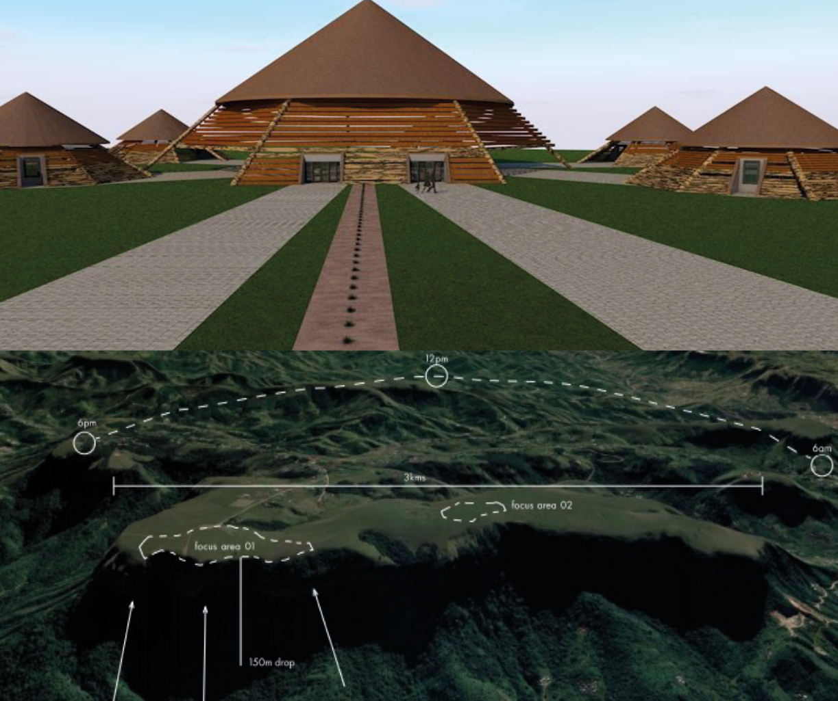
AMATATA MOUNTAIN TOURISM & CULTURAL CENTRE
Description
Development of Amatata Mountain Tourism and Cultural Centre making provision for cultural center amphitheater, cliff-edge restaurant; freedom-walk gallery & information center.
Location
The site is situated in Amatata (Inanda) Mountain which hovers above the AmaQadi, Amaphephetha and whole of Durban, 180 degrees from Ballito to the Bluff.
INVESTMENT VALUE
R52.0
Nearby Towns/Cities
Umhlanga
Durban
Richards Bay
MILLION
Nearby Airport
King Shaka International Airport is 31,8km
Richards Bay Airport is 176,3km
Rationale
The area offers mountain hiking, exploration of
Mzinyathi Falls - a mere 20 minutes from Umhlanga; historical journey through the Inanda Heritage Route
where struggle icons Mahatma Ghanda and John Dube lived.
Project Status
Feasibility study, design development and business plan completed.

Slide 7
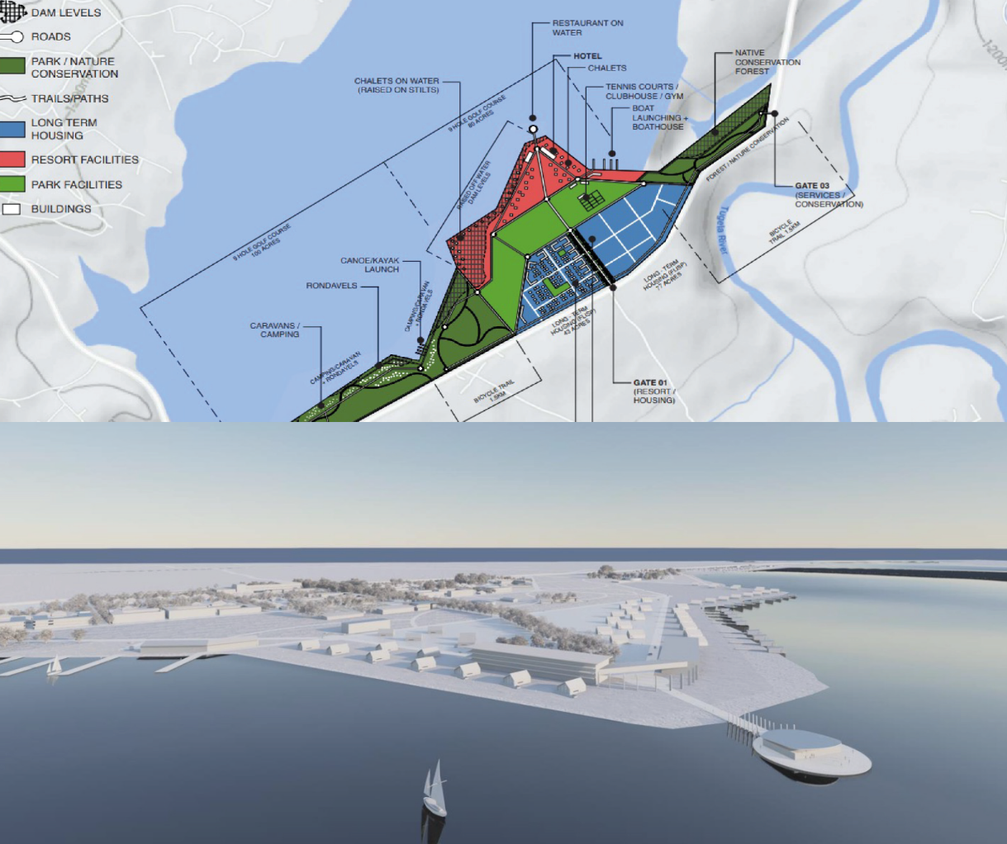
WOODSTOCK DAM RESORT DEVELOPMENT
Description
Development of resort along Woodstock Dam making provision for the hotel, floating restaurant; caravan and camping sites, conference center, gym, horse riding, water sports, quadbikes, a tennis court, golf course, boat launch, and bicycle trails.
Location
Situated in uThukela, Bergville in the Drakensberg World Heritage Site.
INVESTMENT VALUE
R2.9
Nearby Towns/Cities
Bergville
Winterton
Pietermaritzburg
BILLION
Rationale
It offers opportunity to explore the many battlefields, monuments and museums in the Bergville area (situated near the Woodstock Dam); visits to the famous Bergville Cannibal Caves; rock climbing and hiking to the Tugela Falls or river rafting, kayaking,
horse riding, picnicking and trout fishing at Royal Natal National Park.
Project Status
Feasibility study, design development and business plan completed.

Slide 8
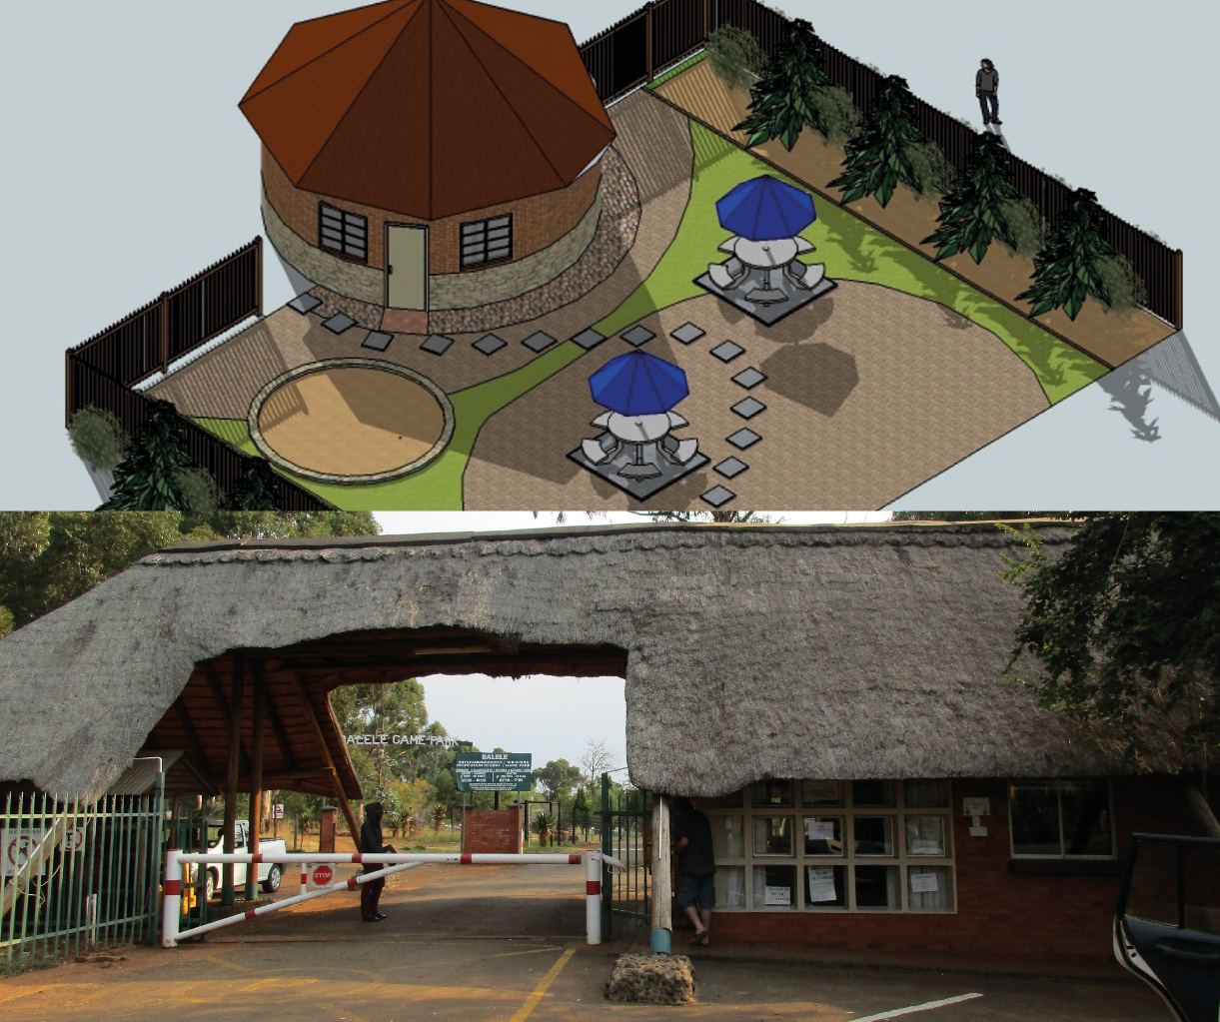
BALELE GAME PARK
Description
The renovation and development of Balele Game Park (theme park, accommodation & recreation facilities) in Utrecht, in Emadlangeni.
Location
Situated inside the town of Utrecht in Emadlangeni Local Municipality.
INVESTMENT VALUE
Nearby Towns/Cities
Newcastle
Dannhauser
R17.4
MILLION
Rationale
The Game Park covers an area of over 2500ha. It offers opportunity to explore adventure activities such as quad bike rides, walking trails, biking trails, water activities, Health Spa opportunity and events. The park boast various animal species including antelopes.
Project Status
Feasibility study, design development and business plan completed. Property is owned by the local
municipality.

Slide 9
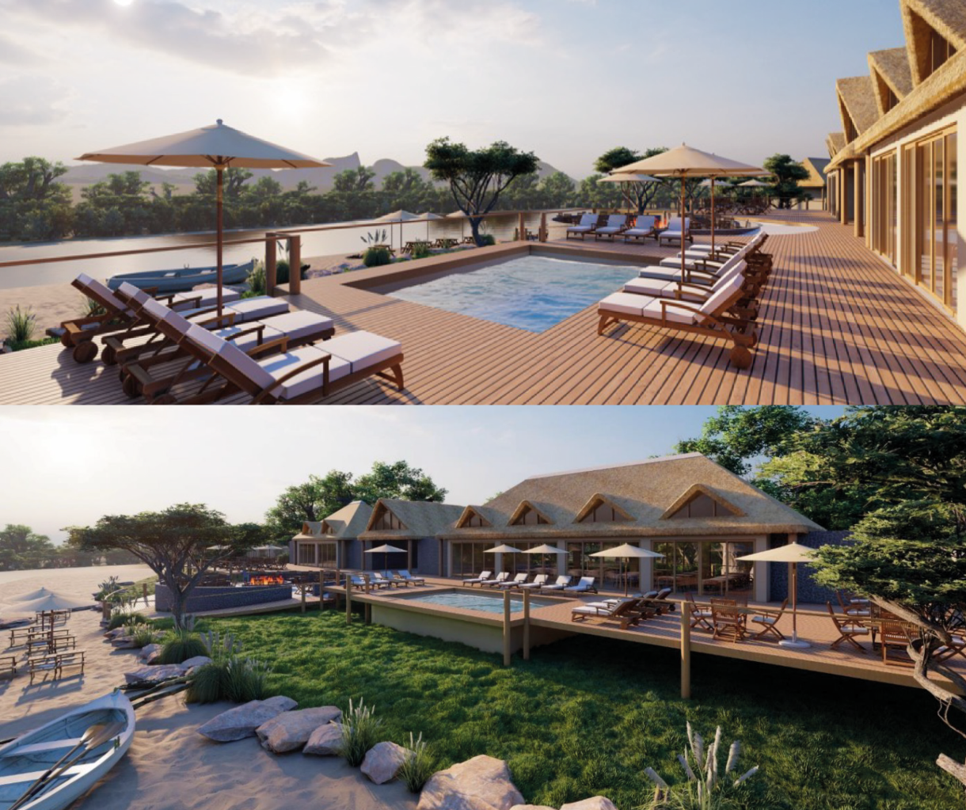
KINGS LODGE
Description
The Development of a proposed nature-based community lodge facilities for local and international tourists. The Lodge includes 26 units and 10 campsites, and a Conference Centre.
Location
Situated in the KwaNyamazane Conservancy area in Jozini, on the Pongola River below Jozini Dam wall in Jozini Local Municipality
INVESTMENT VALUE
R17.4
Nearby Towns/Cities
Richards Bay
Mkhuze
Pongola
Hluhluwe
St Lucia
MILLION
Nearby Airport
King Shaka International Airport is 312km
Richards Bay Airport 175,5km
Rationale
It offers opportunity to explore fishing by kayak or small boat or from the banks of the river, nature and birding walks, trail running, kayaking and
community-based activitie including Meetings, Incentives, Conferences, Events (MICE) facilities.
Project Status
Feasibility study, design development and business plan completed. Land acquired through a lease with the Traditional Authority.

Slide 10
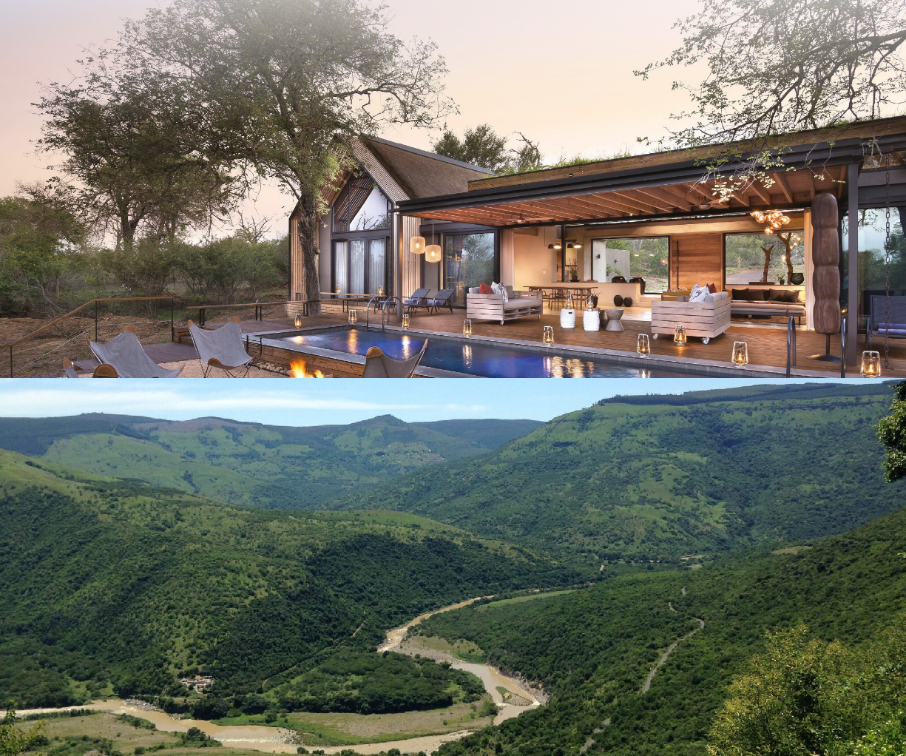
UMKOMAZI RIVER RESORT & SPA
Description & Location
The location meanders along the Umkomazi river, located in the Southern Drakensberg in Impendle Municipality. Five farm sites have been identified for the development of a 5-star holiday resort offering 60 100 hotel rooms, luxury suites that float above the river, and 2-3-bedroom self-contained villas, a hydro spa, an indoor water park, and 18-hole golf course with naturally occurring non-predatory game roaming around the resort..
INVESTMENT VALUE
Nearby Towns/Cities
Durban
Ixopo
Pietermaritzburg
±R250
MILLION
Nearby Airport
King Shaka International Airport: 183 km Pietermaritzburg Airport: 70 km
Rationale
The sites boast of beautiful views of the river and the Southern Drakensberg mountains, the area is also well-known for its protected bushman paintings/rock art - all which make it a prime setting for the development of a 4–5-star holiday resort destination to attract local and international tourists to the area, thus injecting much needed foreign currency into the economy and the municipality.
Project Status
The area has been cleared by the municipality mapping department as falling outside of the Drakensberg Transfrontier Conservation areas.

Slide 11
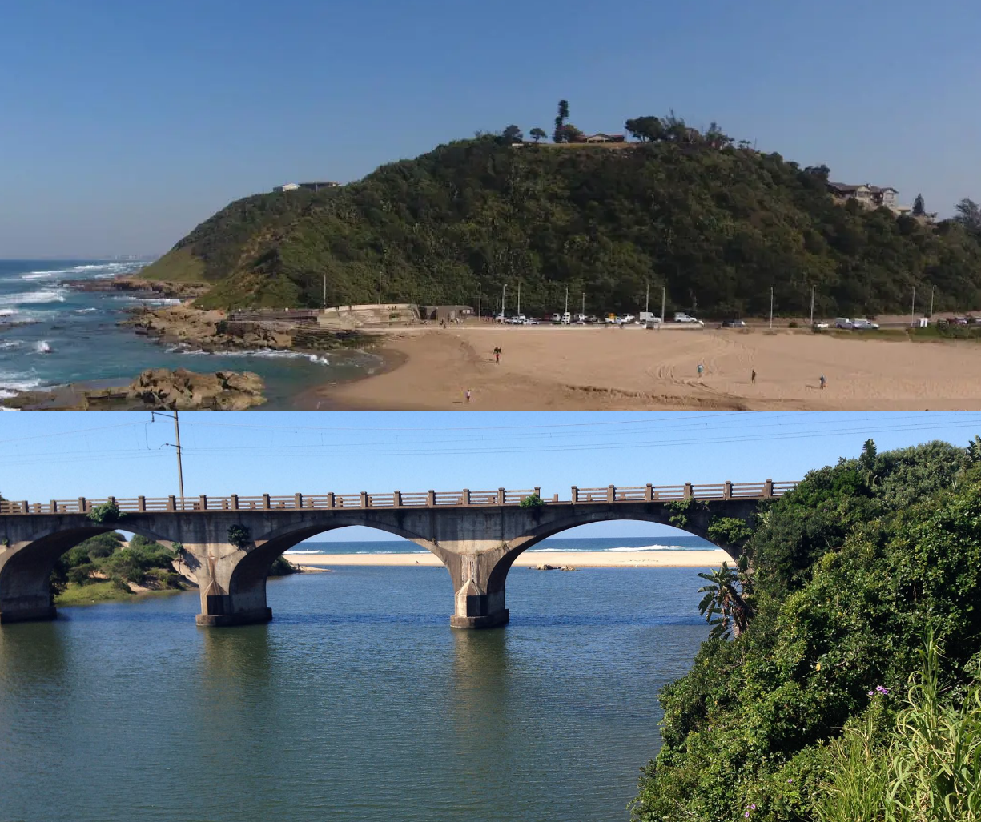
UMGABABA COASTAL RESORT
Description & Location
Known for its beauty and profound history, the planned resort located at Umgababa beach on the south coast of Kwazulu-Natal, has the propensity for tourism opportunities and job creation for locals surrounding the rural area.
Nearby Towns/Cities
Durban
Port Shepstone
Umhlanga
Ballito
INVESTMENT VALUE
R40
Nearby Airport
King Shaka International Airport: 69.7 km Pietermaritzburg Airport: 87.7 km
MILLION
Rationale
The Umgababa Coastal Resort will attract tourism by providing a business conference centre, on-site restaurant, accommodation, corporate events, team building facilities, wedding venue, water theme park for adults and children, and outdoor events.
Project Status
Approval was obtained from Traditional Authority and Ingonyama Trust
Construction has begun; however, the building is not 100% completed

Slide 12

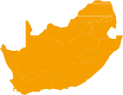
REASONS TO INVEST
IN KWAZULU-NATAL
ECONOMIC STATISTICS
KwaZulu-Natal: Key Indicators: 2022
EXTENSIVE FIRST-WORLD
ROAD, RAIL, SEA AND AIR
INFRASTRUCTURE
Rated in top 5 ‘quality of living’ cities in Africa and Middle East by Mercer Consulting in 2015 and 2016
Durban was ranked as the least congested metro city in SA, according to the global
Population:
11.5 MILLION
Capital City:
PIETERMARITZBURG,
KWAZULU-NATAL
South Africa’s second
largest industrial region
One of the best Credit Ratings in SA municipal sector
R754
BILLION
R700
BILLION
Gross Domestic Product
4,9%
GVA Average Annual Growth (2022)
ON DURBAN INVESTMENT’S DASHBOARD & 2016 WINNER OF “KZN TOP BUSINESS PORTFOLIO AWARD” FOR BEST INVESTMENT PROMOTION
GDP per capita:
Ranked
₈th
in South Africa by GDP
Rated by the New York Times as number 7 of their Top 52 Places to Go in 2015
SA’s “Top performing City for growth in millionaires since 2000” - New World Wealth Report, 2015
10.406
33,2%
Unemployment Rate 2022
94 361 km²
Geographic area

