Slide 1
INVESTMENT AND BUSINESS OPPORTUNITIES
Tourism Investment Forum Africa
08 JUNE 2023
Presented by: CLAYTON KARNA

Slide 2
JUNE 2023
1
ACSA OVERVIEW
2
AIRPORT OVERVIEW
3
PERFORMANCE OVERVIEW
MASTERPLAN
4
5
AVIATION PARK
Notes:
s

Slide 3
ACSA OVERVIEW

Slide 4
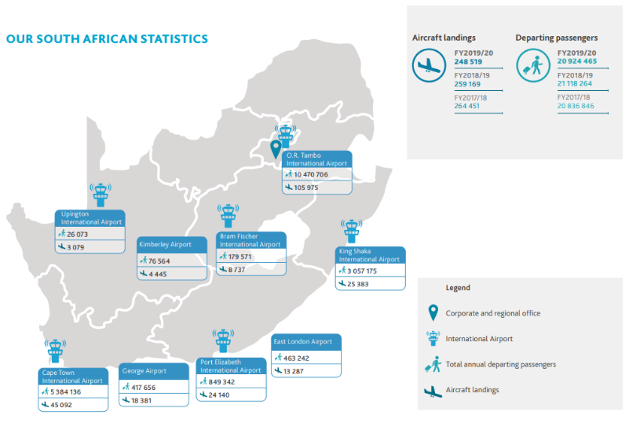
AIRPORTS COMPANY SOUTH AFRICA OVERVIEW
Airports Company South Africa SOC Ltd (ACSA or the Group or the Company) owns and operates South Africa’s nine key airports, including its three major international gateways: O.R. Tambo, Cape Town and King Shaka International Airports.

Slide 5




ACSA STRATEGY
Run Airports
Now - 2025:Timeframe #1
Extend and defend core businesses.
Explore emerging businesses
Minimal Capex (Replace and Refurbish).
Vision
Develop Airports
2026 – 2030: Timeframe #2
Build emerging businesses to drive revenue growth Ensure company’s longer-term future.
More Investment Partnerships
To be the most sought-after partner in the world for the provision of sustainable airport management solutions by 2030.
Grow footprint
Beyond 2030: Timeframe #3
Operate the new ACSA with a redirected focus and growth trajectory.
Pronounced Growth.
BUSINESS PRIORITIES
People and culture Governance | Leadership, organisational design and performance Revised Governance Framework and Operating Model
Operational Efficiency Digitisation | Insource / Outsource Artificial Intelligence Thermographic solution

Slide 6
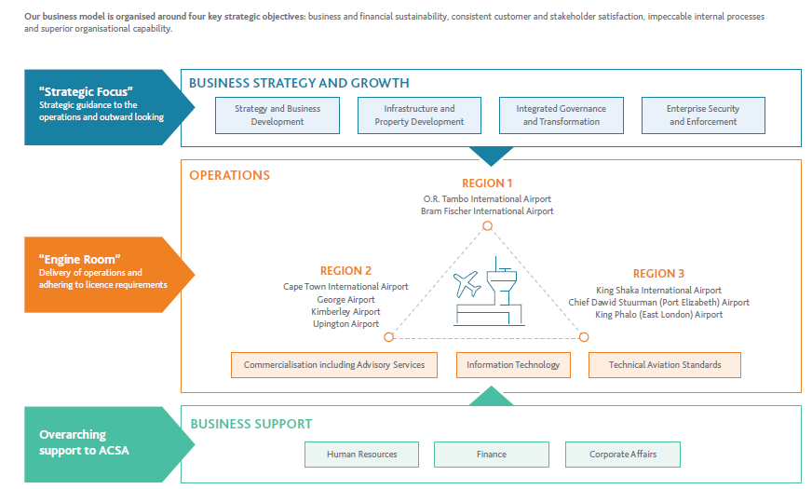
ACSA BUSINESS MODEL

Slide 7
UPINGTON INTERNATIONAL AIRPORT OVERVIEW

Slide 8
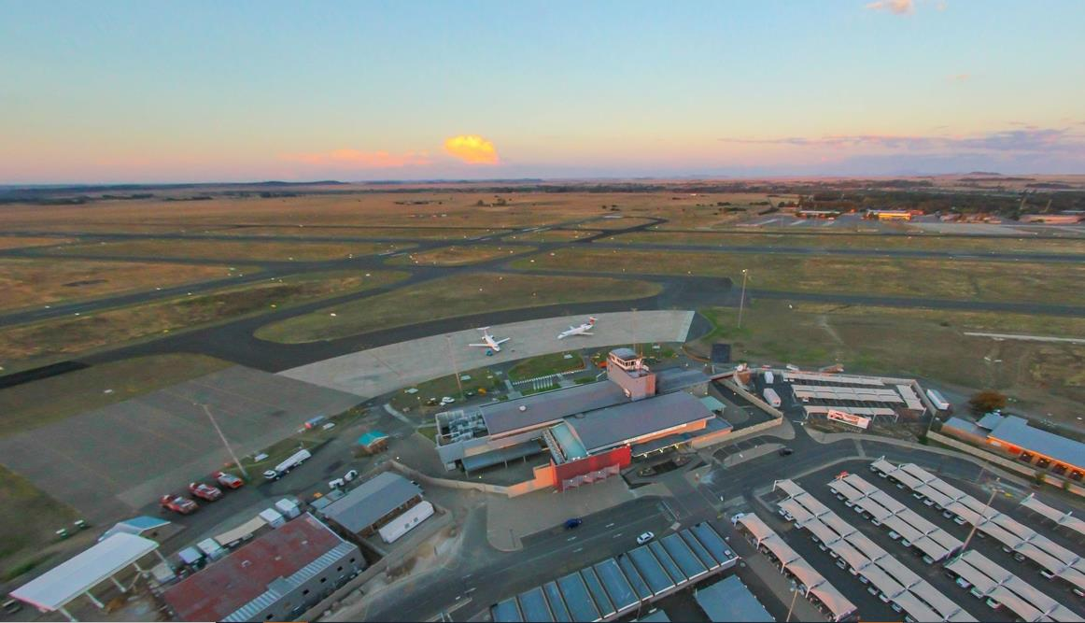
Africa’s most award-winning airport
Capacity for 15 MILL Passengers P/A
Reaching 8,5 mill passengers p/a (11m in 2019)
On-time performance of + 90% (16th in the world)
30k passengers per day (+35k in 2019)
+ 220 flights per day (+300 in 2019)
1.8 mill liters aviation fuel per day (2023)
Over 100 leading brands located on site
Airport snapshot
8
Notes:
Do you have any smart pictures like this of the airport? – Clearer picture required

Slide 9
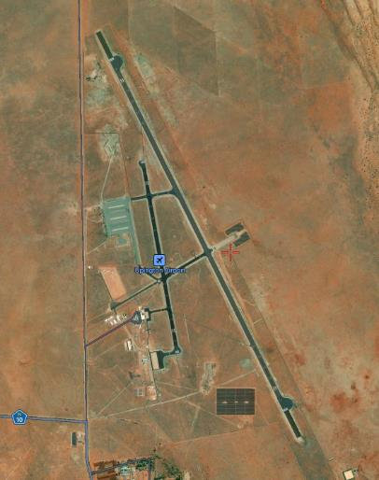
Upington airport overview
The airport features a modern terminal building with facilities for passengers, including check-in counters, baggage handling areas, security checkpoints, and boarding gates.
Upington Airport has 3 runways. The main runway is 4,900 meters long, making it one of the longest runways in the world.
Upington Airport serves as a regional hub, connecting the Northern Cape with other parts of South Africa.

Slide 10
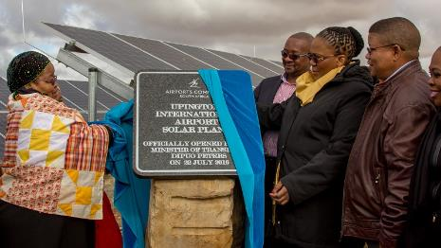
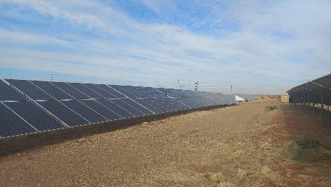
Upington airport – A CHOICE LOCATION
Longest civilian runway in Southern hemisphere, suitable for all aircraft types.
Ample space for aircraft parking and development of facilities.
Self-sufficient power supply using solar photovoltaics.
Space available for development of custom facilities and unrestricted operations.
Not slot coordinated - no airspace congestion or noise restrictions.
Dry climate is ideal for aircraft storage and maintenance.
Notes:
Please send a picture of the solar plant if available

Slide 11
Key Infrastructure Features of Upington Airport
Cold Storage Facilities
Upington Airport offers ample space for cold storage facilities.
The availability of cold storage facilities enhances the airport's capabilities in handling cargo.
Sufficient Parking Bay
Upington Airport provides a spacious and well-designed parking area.
Fuel Depot
The availability of a fuel depot ensures efficient refuelling operations and supports the overall functioning of the airport.
Energy-Saving Initiatives
Upington Airport emphasizes energy efficiency as a priority.
Runway length
Upington Airport boasts a substantial runway length.
The extended runway provides the airport with the capability to accommodate a wide range of aircraft, including larger commercial planes and cargo carriers.
Cold Storage Facilities
Sufficient Parking Bay
Fuel Depot
Energy-Saving
Runway length

Slide 12
PERFORMANCE OVERVIEW

Slide 13
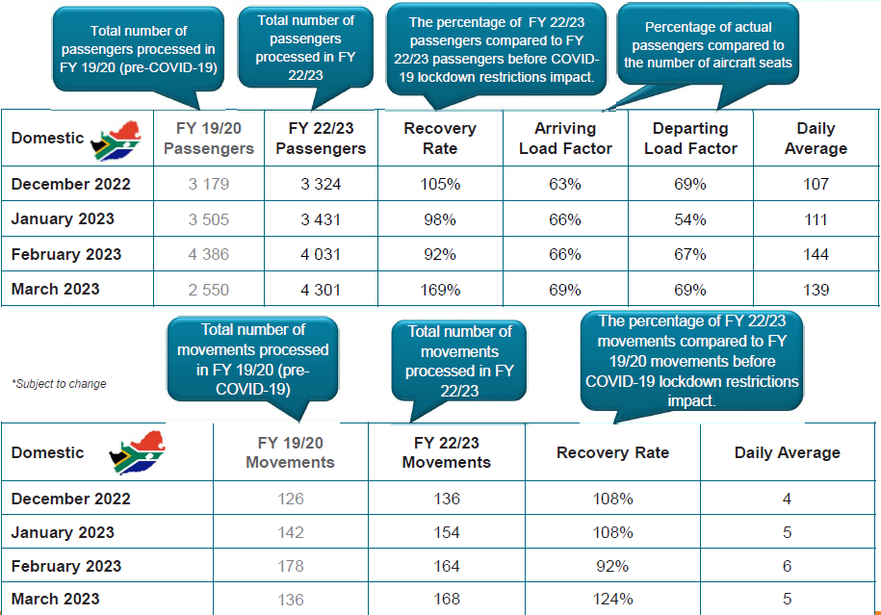
UPINGTON AIRPORT TRAFFIC FORECAST
Notes:
Include the recovery rates and updates slides

Slide 14
UPINGTON MASTER PLAN

Slide 15
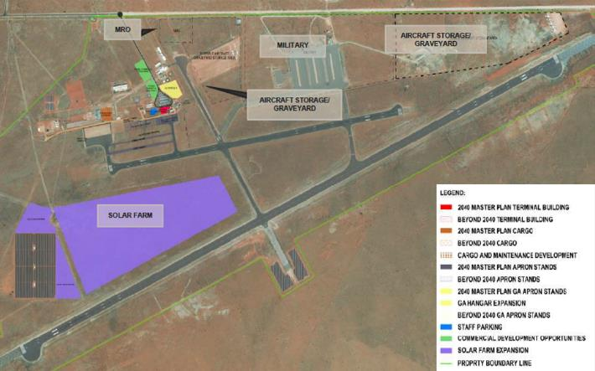
Upington (PROPOSED) masterplan
Solar farm can be seen in the image on the right allocated in purple.
±80 hectares available.
Aircraft storage/Graveyard can be seen on the right.
Commercial development opportunity allocated in light green.
Maintenance Repair and Overhaul (MRO) area can be seen in top of the image.
Notes:
I need a clearer picture – Highlight the Aviation Park

Slide 16
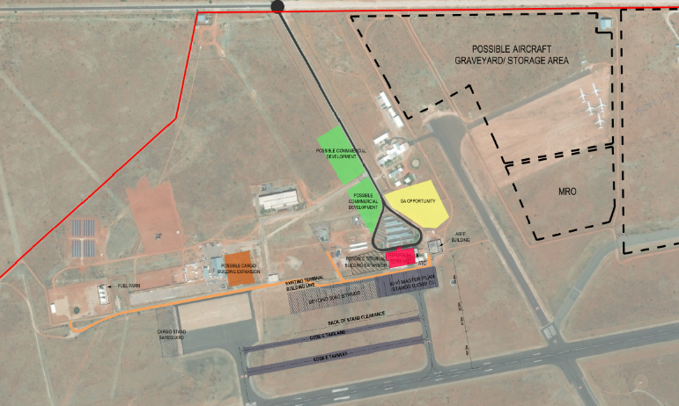
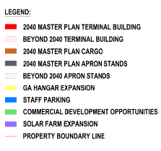
Commercial development Opportunities
Typical commercial opportunities have been identified in several key areas, including:
Retail and duty-free shops
Food and beverage outlets
Airport lounges
Hotel development sites
Fuelling stations near the airport
Cold storage facilities
Availability of warehouse space
To ensure the viability of these options, market research will be necessary.
Notes:
What about cargo and car testing and film shoots, etc.

Slide 17
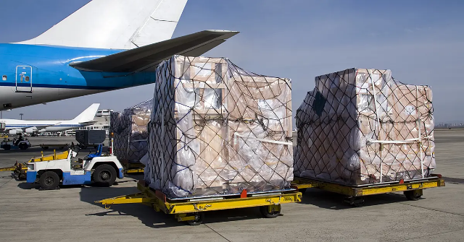
Cargo Development
  Upington Airport strengths and opportunities:
    Infrastructure and space for expansion
    Congestion at JNB.
    Long term growth of perishables market.
    Potential for growth in automotive industry is limited.
  Upington Airport weaknesses and threats:
    Improvement of sea freight.
    Lack of strategy and integration.
    Inertia of main market players.
    Weakness of home carrier.

Slide 18
UPINGTON AVIATION PARK

Slide 19
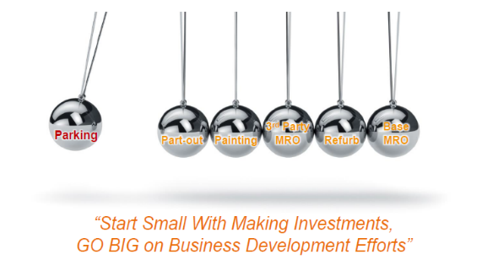
DEMAND FOR UPINGTON AVIATION PARK
ACSA commissioned due diligence for an aviation park in Upington Airport. The key outcomes are:
With continued growth and ageing of commercial aircraft fleet the business of storing, scrapping, recycling and refurbishing of aircraft on the African continent seems assured.
As business at the Upington Aviation Park grows opportunities arise for both independent third party maintenance and airline base maintenance.
Explore cargo growth opportunities for perishables and logistics for parts, including freighter tag flights.

Slide 20
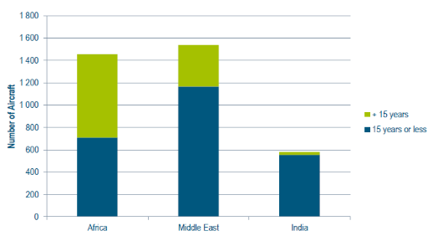
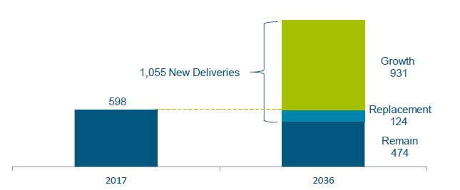
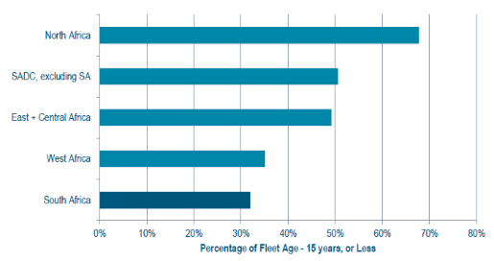
Drivers for investment
There are strong drivers for the investment in MRO facilities in Africa.
This is depicted by the following graphs:
Age of aircraft fleet (column chart)
Age of aircraft fleet (bar chart)
Airbus Africa Forecast
Age of aircraft fleet
Airbus Africa Forecast
Age of aircraft fleet
Notes:
What is the Airbus Africa Forecast showing us?

Slide 21
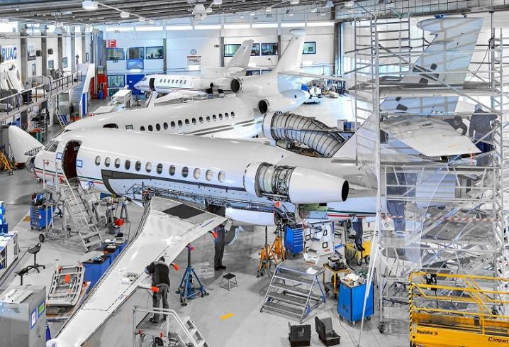
Business Opportunities at UPINGTON Aviation Park
Aircraft Parking/Storage (Hangars)
  Temporary between leases
  Aircraft manufacturers
  Airworthiness maintenance
Aircraft Scrapping
  Not valuable for parts
  Owner pays for scrapping
  Scrapping firm sells waste materials
Aircraft Dismantling
  Valuable parts
  Dismantling firm buys aircraft
  Dismantling firm sells parts

Slide 22
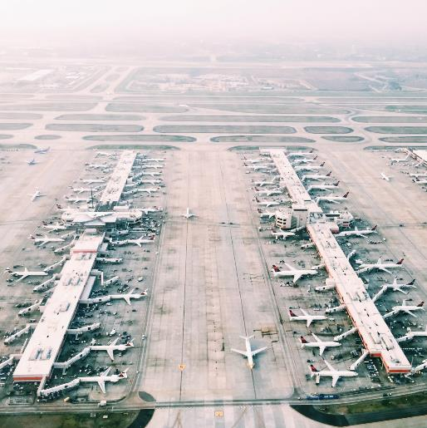
STORAGE, SCRAPPING, DISMANTLING FACILITIES
  Operation of such facilities are regulated which ensures strict governance and assurance. This fits well into an Airport Company’s skill set
  There are a handful of such facilities around the world. In Europe, storage facilities
  exist in:
  Cotswold, UK
  Twente, Netherlands
  Teruel, Spain
  Tarbes and Francazal, France
  Component recovery, refurbishment are growing businesses in the aviation industry.

Slide 23
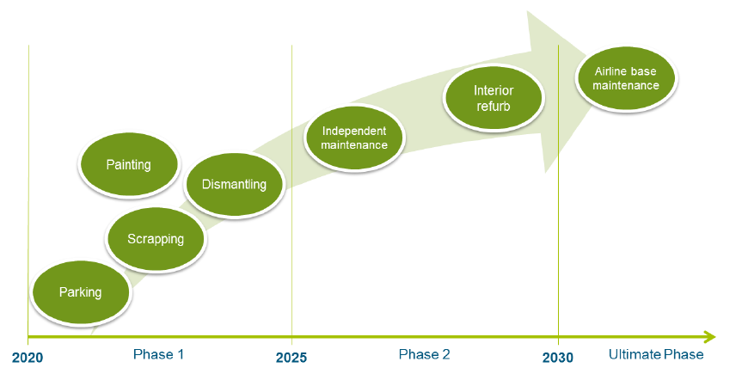
UPINGTON Aviation Park PHASED APPROACH
3 Phases rolled out over 10 plus years.
Phase 1 (5yrs): Aircraft parking, scrapping, dismantling & painting facilities.
Phase 2 (5yrs): Independent third-party MRO & interior refurbishment.
Phase3 Final phase: Airline MRO base. Year 10 and onward
Notes:
Should we talk about the tender?

Slide 24
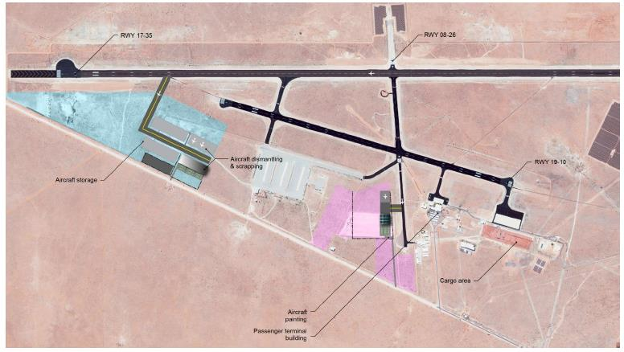
Upington Aviation Park – Phase 1 layout
Notes:
Clearer pictures

Slide 25
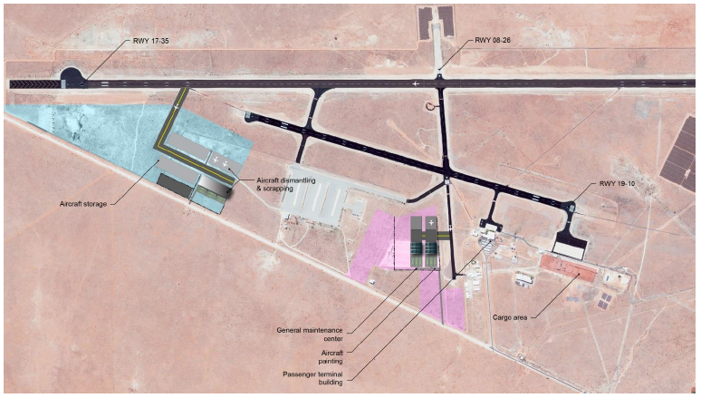
Upington Aviation Park – Phase 2 layout

Slide 26
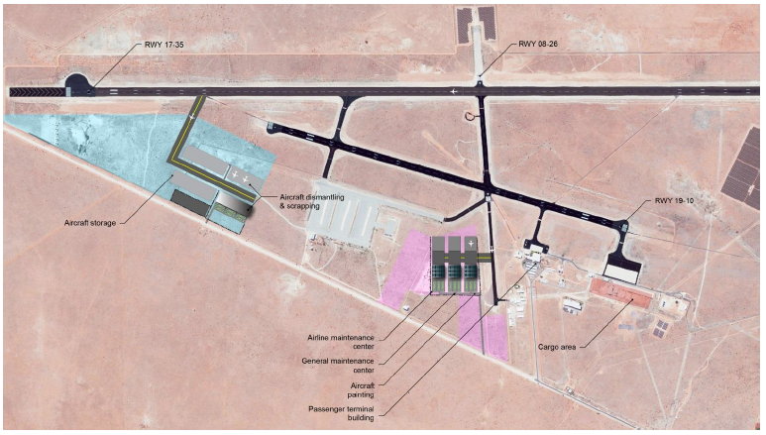
Upington Aviation Park – ULTIMATE layout

Slide 27
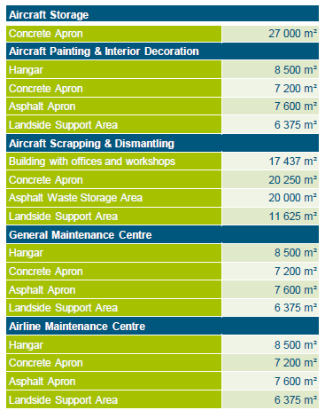
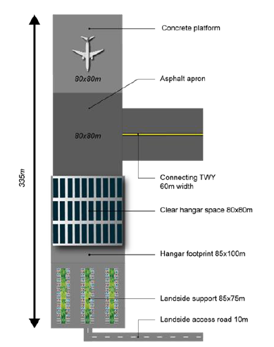
Infrastructure Requirements

Slide 28
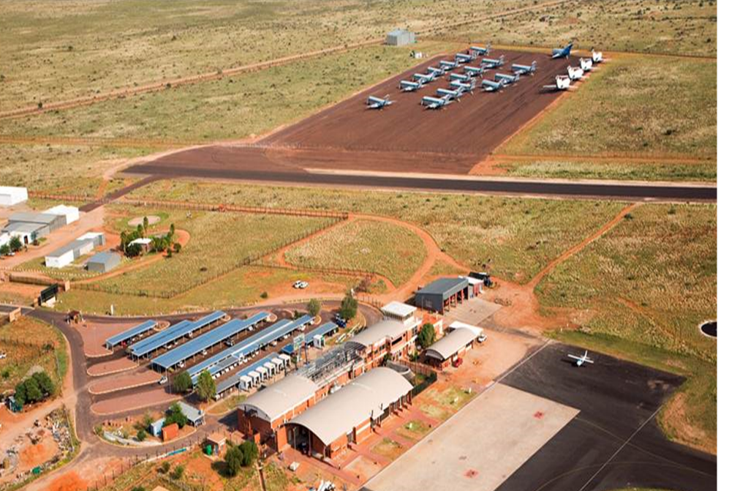
Previous aircraft storage

Slide 29
Collaboration between acsa and OTHER KEY STAKEHOLDERS
MOU for the Air Service Development Project signed in 2019 (ACSA, DEDaT, DKM, NCEDA, NOCCI).
NCEDA is incubating various business opportunities with investors, including renewable energy, mining, and car seat upholstery.
A business park (Upington Industrial Park) has been established adjacent to ACSA's Aviation Park land.

Slide 30

conclusion
  With continuing growth of the commercial aircraft fleet, the business of storing, recycling
  or replacements for aging aircraft on the African continent seems assured. The following steps will need to be taken to develop these opportunities.
  Gather business development momentum
  Secure initial commitments from potential operators.
  Proceed with detailed planning, design and construction of infrastructure to prospective tenant requirements.

Slide 31
DISCLAIMER
The information contained in this presentation is confidential, and is intended solely for this presentation. This presentation may contain information proprietary to the Airports Company South Africa SOC Limited (“the Company”), and may not be reproduced or disseminated in whole or in part without the Company's written consent. The Company is not acting as your adviser in any transaction that may be proposed herein, and this presentation does not constitute a recommendation, guidance or proposal to enter into any transaction.
Any decision to enter into a transaction should be made on the basis of information contained within an offering circular, programme memorandum
or prospectus published in relation to such an offering. The Company does not guarantee or otherwise assure the expected results of any transaction
as envisaged in this presentation. You shall not be entitled to place any reliance on the information contained in this presentation for the purposes
of entering into any proposed transaction or otherwise.
Thank
you

