Slide 1
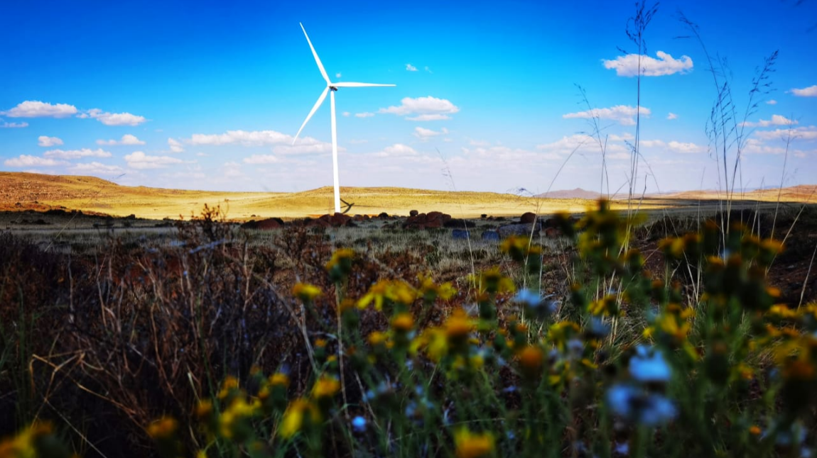

NORTHERN CAPE, YOUR INVESTMENT PARTNER
Presented by : Riaan Warie – Acting Chief Director: Trade and Sector Development
June 2023

Slide 2
PRESENTATION OUTLINE
  Well-Governed State and the Province
  Northern Cape Geographical Location
  Drivers of Growth and Development: Vision 2040
  Economic Analysis
  Priority Sectors
  Northern Cape Sector Focus:
  Agriculture; Mining; Tourism and Hunting; Renewable Energy and Green Hydrogen
  Northern Cape Investment Corridor
  High Impact Projects

Slide 3
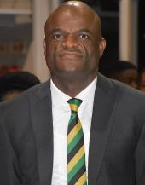
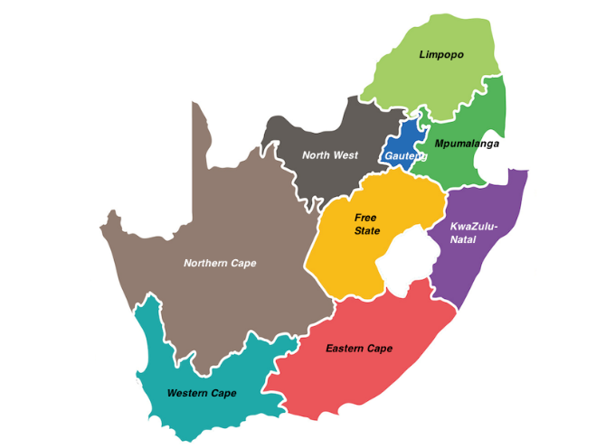
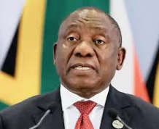
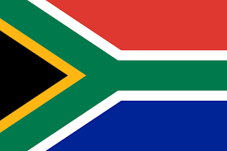
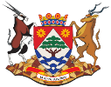
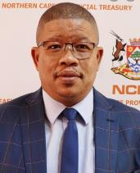

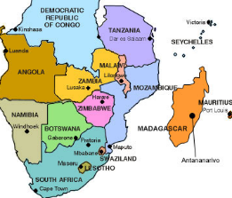

WELL-GOVERNED SOUTH AFRICA AND NORTHERN CAPE
1
2
3
Northern Cape Premier:
Dr Zamani Saul
Northern
Cape
South African President:
Mr Cyril Ramaphosa
4
5
6
MEC: Finance, Economic Development & Tourism: Mr Abraham Vosloo

Slide 4
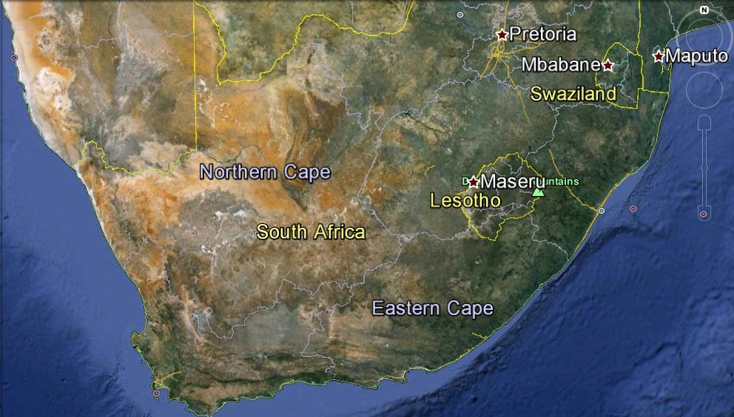
NORTHERN CAPE GEOGRAPHIC LOCATION
Fast facts:
2x size of Gauteng &
Larger than Germany;
Largest province in SA in land mass;
Languages: Afrikaans, Tswana, Xhosa and English;
Population of 1.3 million people.

Slide 5
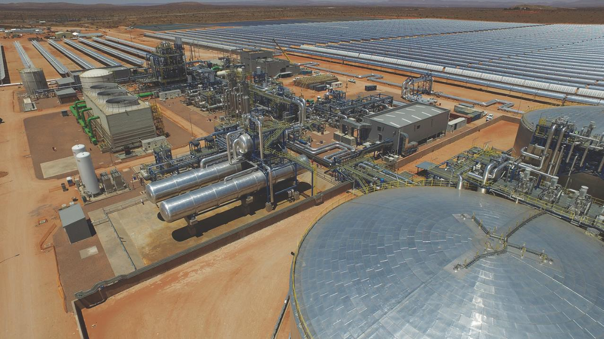
DRIVERS OF GROWTH AND DEVELOPMENT
VISION 2040
1
2
3
4
Economic Transformation, Development and Prosperity
Social Equity & Human Welfare
Environmental Sustainability and Resilience
Accountable & Effective Governance
Agriculture and Agro-Processing
Mining and Mineral Beneficiation
Tourism Market Development
Development of the Energy Sector
Manufacturing and Trade
Competitive Infrastructure Development
Employment and Skills Development
Innovation and knowledge economy
The Maritime Economy
Quality Basic Education
Social Cohesion and Community Participation
Social Protection and Safety
Health
Rural Development, Land Reform and Food Security.
Improve Environmental Sustainability
Accountable Local Government
Development Orientated Public Services

Slide 6
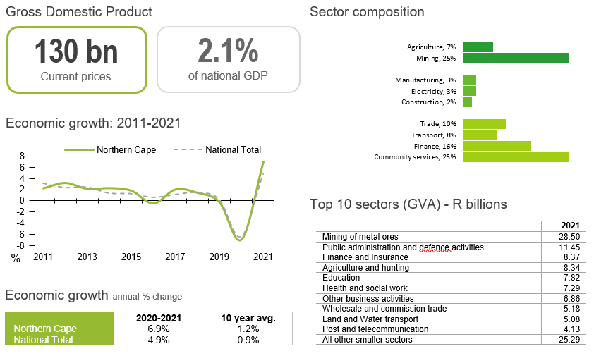
NORTHERN CAPE STATISTICAL OVERVIEW
Kimberley is the capital city. The main languages are Afrikaans 53.8%, Tswana 33.1%, Xhosa 5.3% and English 3.4%

Slide 7
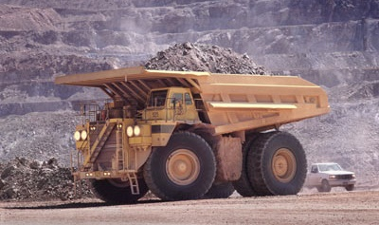
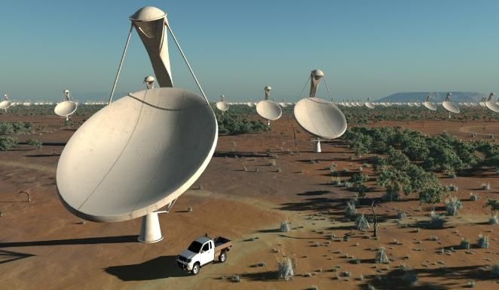
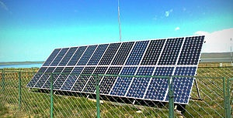
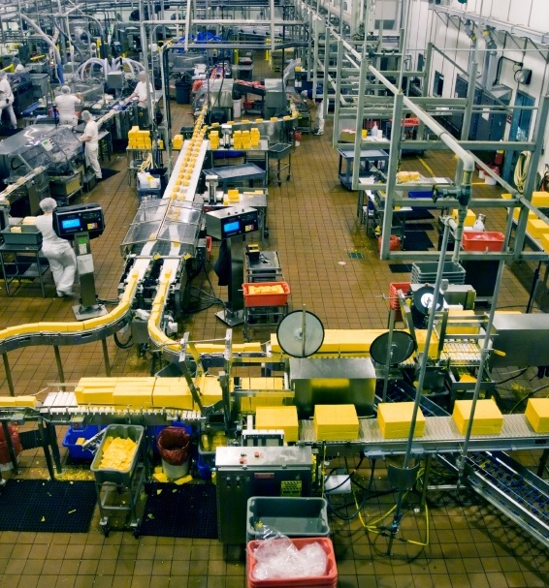
Mining and Mineral Beneficiation
Knowledge Economy
Fishing and Aquaculture
Tourism
PRIORITY SECTORS
Construction and Infrastructure
Manufacturing
Agriculture, and Agro processing
Energy

Slide 8
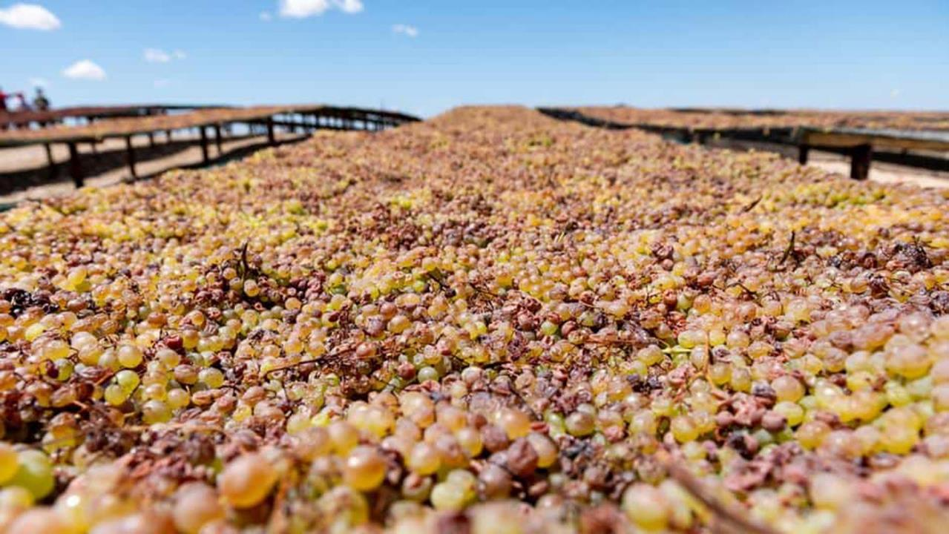


SECTOR FOCUS: AGRICULTURE

Slide 9
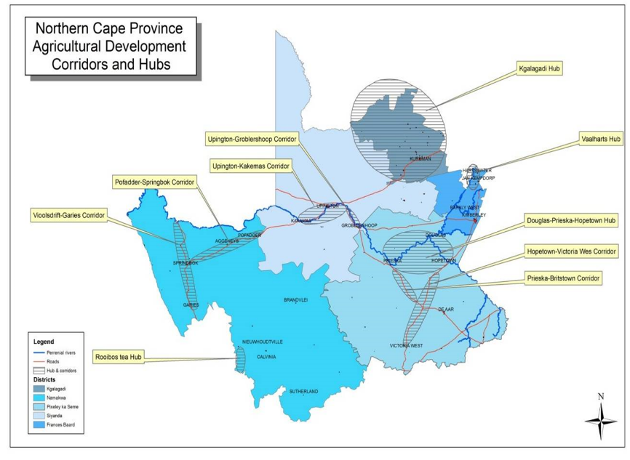
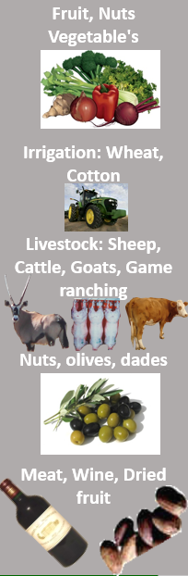
NORTHERN CAPE AGRICULTURAL CORRIDOR
RANGE OF PRODUCT
1
2
3
4
5
6

Slide 10
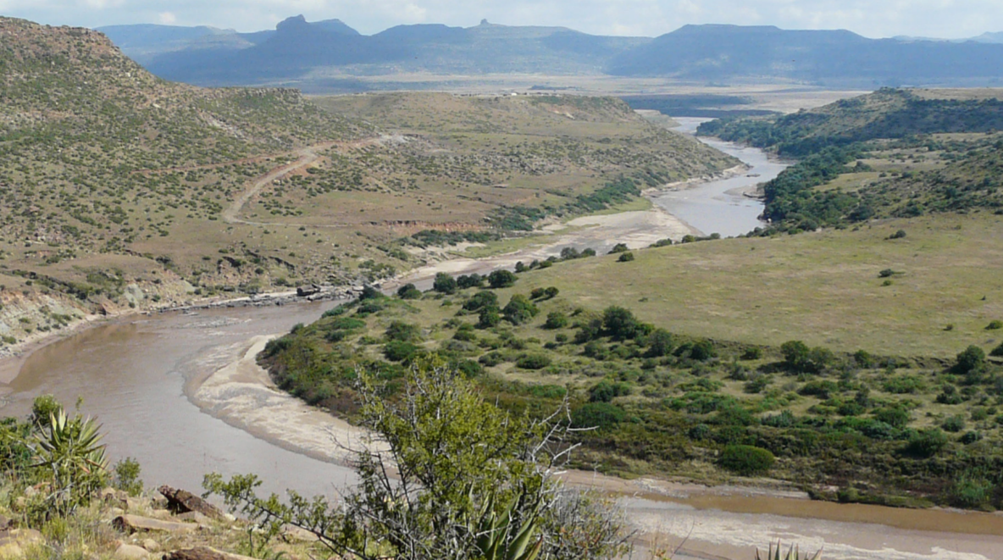
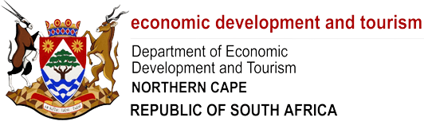
THE LOWER ORANGE RIVER

Slide 11
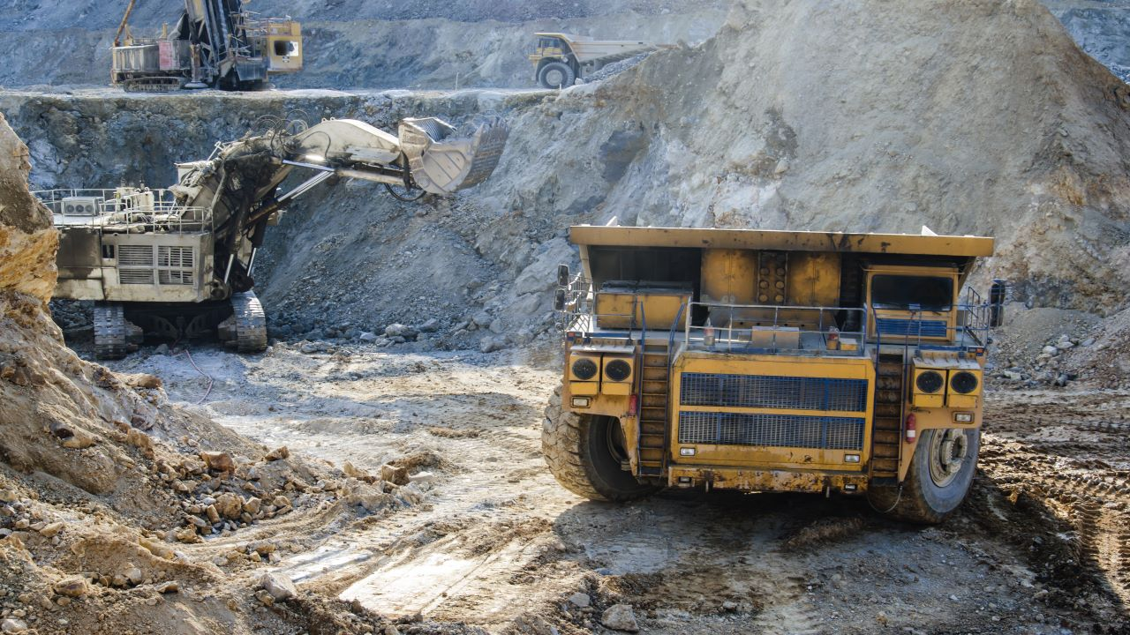
SECTOR FOCUS: MINING PORTFOLIO

Slide 12
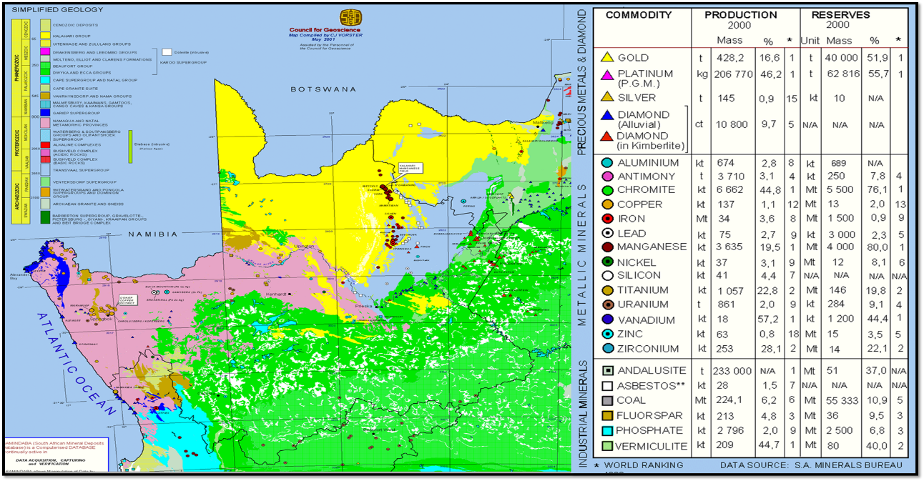
MINERALS IN THE NORTHERN CAPE
1
2
3
4
5
6

Slide 13

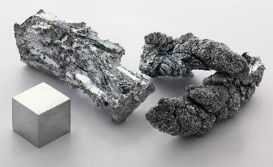
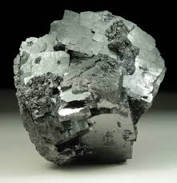
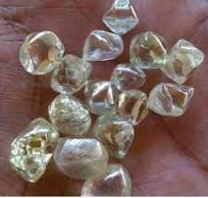
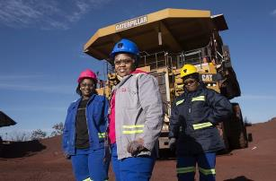
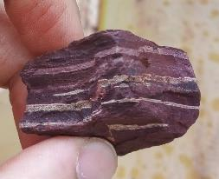
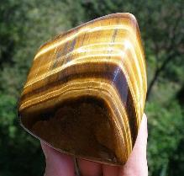
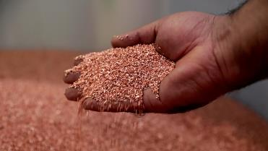
MINING FACTS
“Mining contributes 23.4% to the Northern Cape economy and makes up nearly 7% of SA’s total mining value with significant deposits of iron ore, manganese, zinc, copper, lead, titanium, pig iron, zircon and gypsum. The availability of natural resources, labour and infrastructure (including the Sishen-Saldanha railway line), make Sishen the country’s most important iron-ore mine, where operations include extraction and four beneficiation plants”.

Slide 14
MINING FACTS
The province is considered the largest locally found resource hub for new tech minerals in the current mining boom:
  zinc, nickel, lead, copper and cobalt feature prominently.
These key elements are pivotal in the manufacturing of smartphones, electric vehicles and renewable power systems.

Slide 15
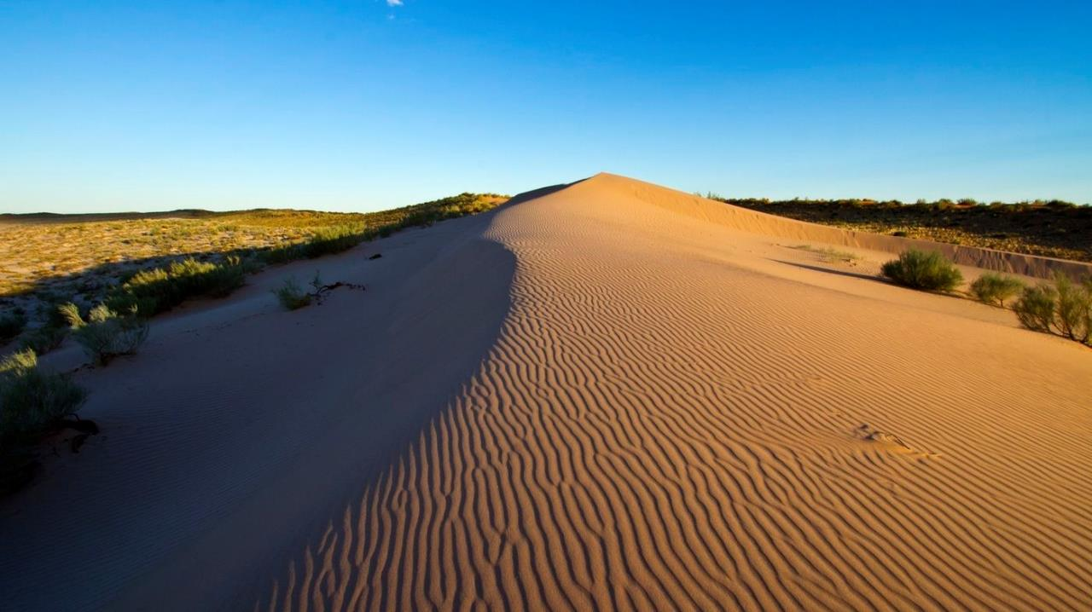
SECTOR FOCUS: OCEANS ECONOMY

Slide 16

Oceans Economy
  Ocean Economy:
Notwithstanding growth in the abalone, fishing and lobster industries, economic potential lies in the 313km coastline, encouraged by the national Oceans Economy programme, with Port Nolloth, Boegoebaai and Hondeklip Bay harbours targeted for development. The latter has already received investment in the aquaculture sector. The province has been allocated an increased quota for landing fish (primarily hake) which makes Port Nolloth attractive for investment in fish processing and abalone ranching. The best Kelp in the world is found in the Northern Cape.
1
2
3
5
6

Slide 17
SECTOR FOCUS: TOURISM AND HUNTING

Slide 18
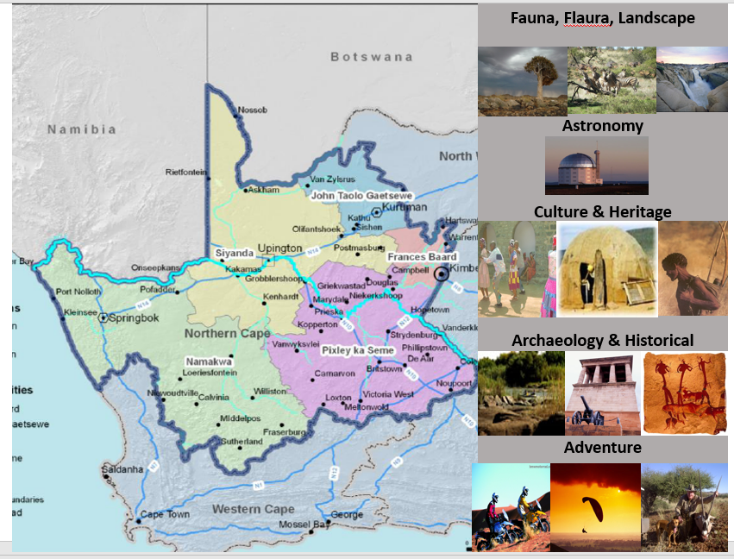
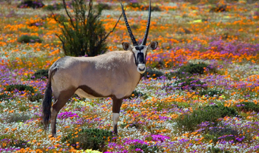
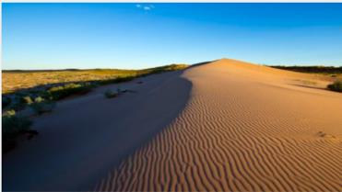
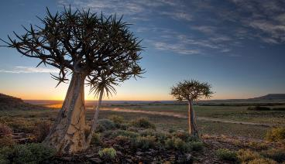
NORTHERN CAPE TOURISM AND HUNTING
1
2
3
4
5
6
“The Northern Cape boasts unparalleled spring flower displays, six national parks and five provincial reserves including the Kgalagadi Transfrontier Park (with Botswana) encompassing 3.7m hectares. Hunting is a lucrative subsector, contributing to the economic development of rural communities”.

Slide 19
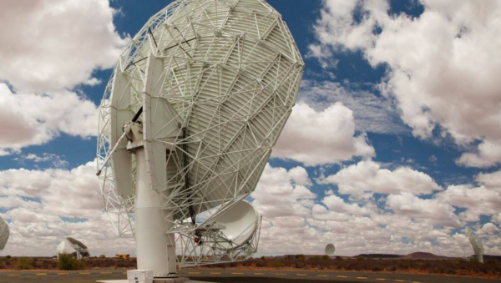
SECTOR FOCUS: 4IR, ICT AND ASTRONOMY

Slide 20
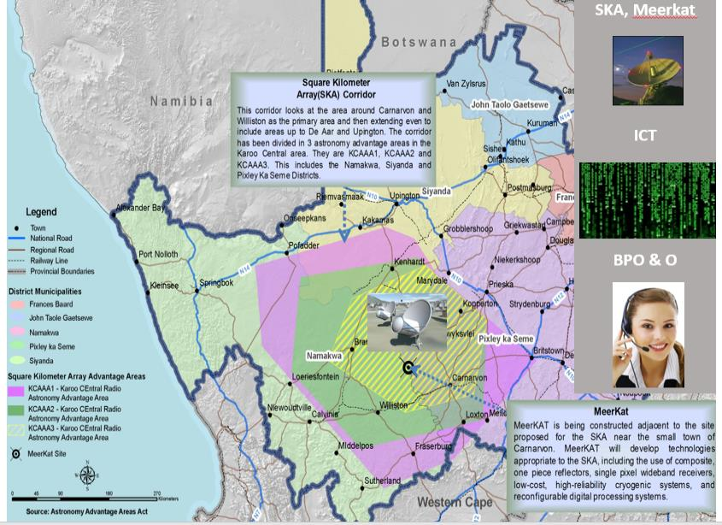
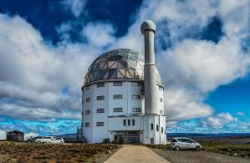
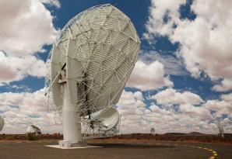
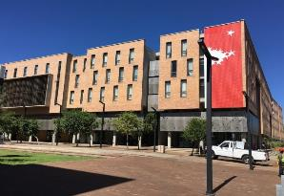
4IR, ICT AND ASTRONOMY
1
2
3
4
5
6

Slide 21
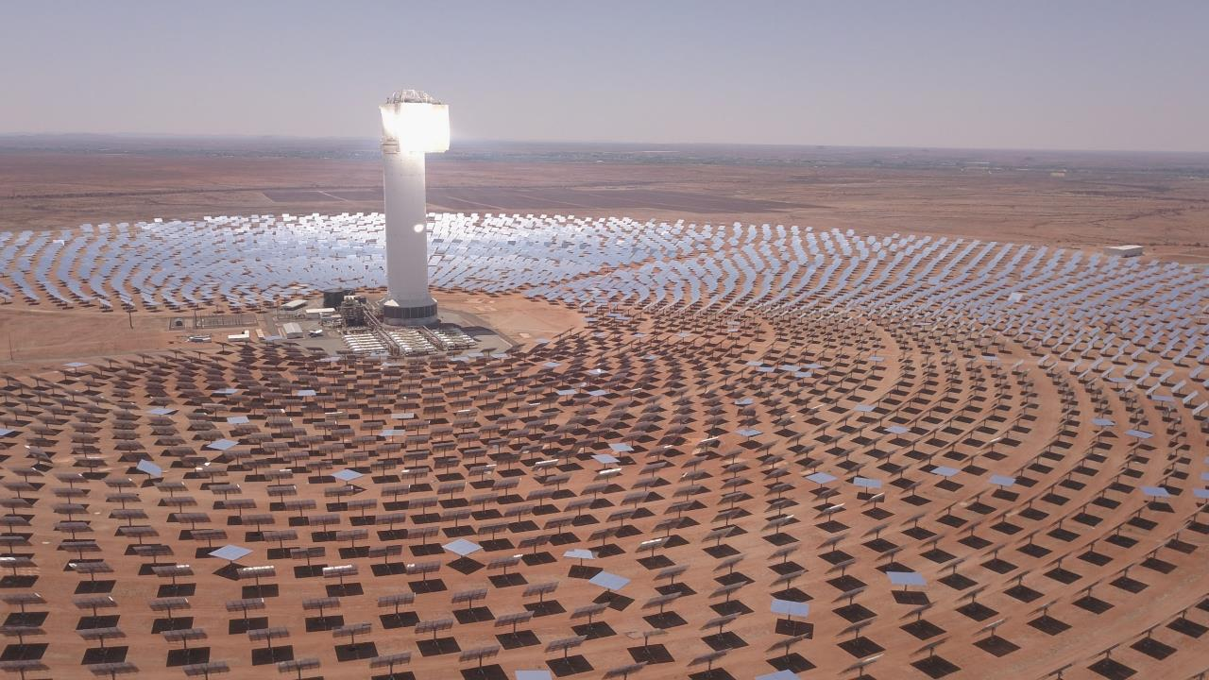
SECTOR FOCUS: RENEWABLE ENERGY AND GREEN HYDROGEN

Slide 22
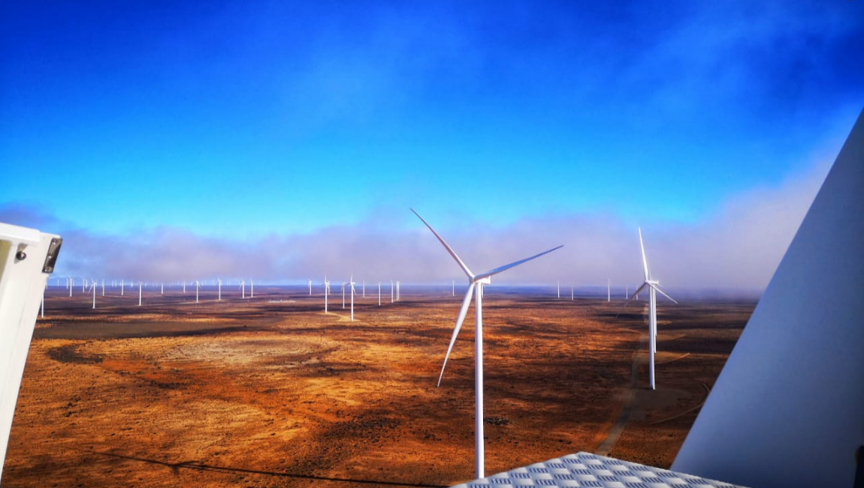
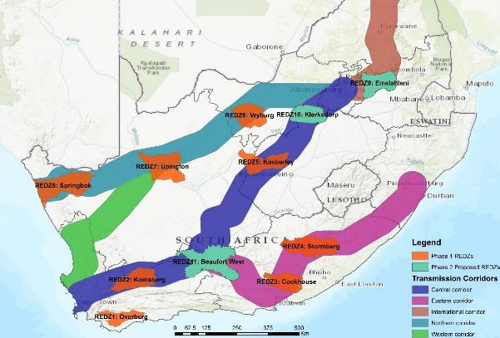
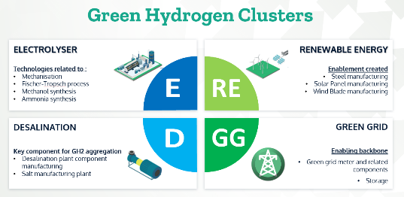
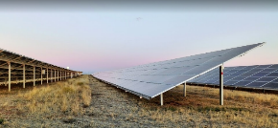





NORTHERN CAPE RENEWABLE ENERGY NODES
GENERATION AND TRANSMISSION NODES
Local PV panel and wind turbine manufacturing
Promote NCs green
H₂ and RE component
manufacturing potential centred around NCs SEZ & industrial park network. Attract tier-1 PV panel and wind turbine manufacturers to
the Northern Cape by 2025;
DOWNSTREAM TRIGGERED ACTIVITIES
GREEN PRODUCTION
GREEN ECONOMY ENABLEMENT THROUGH GH2
Skills
Development
Partner with the private sector and existing institutions of higher learning to develop a green H₂ training
academy in NC to ensure
development of necessary skills to support this nascent sub-sector;
GLASS
CEMENT
STEEL
OTHER

Slide 23
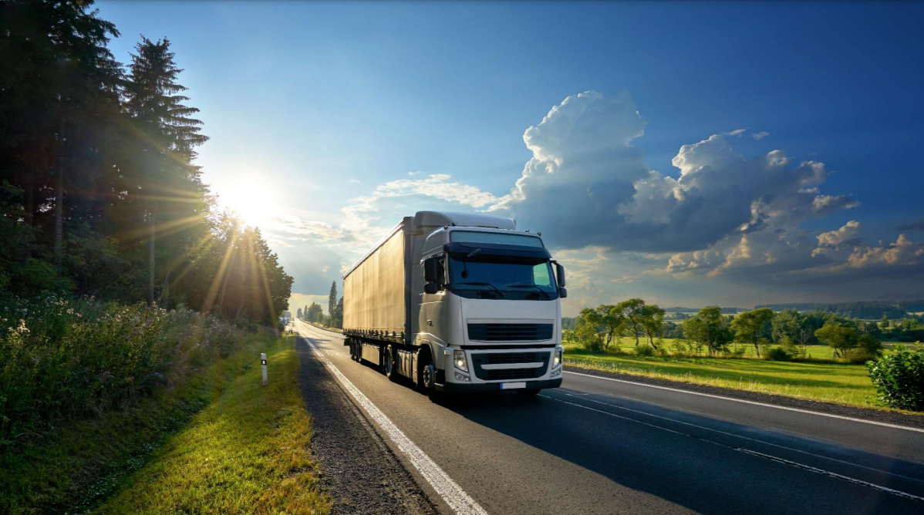
NORTHERN CAPE CORRIDOR

Slide 24
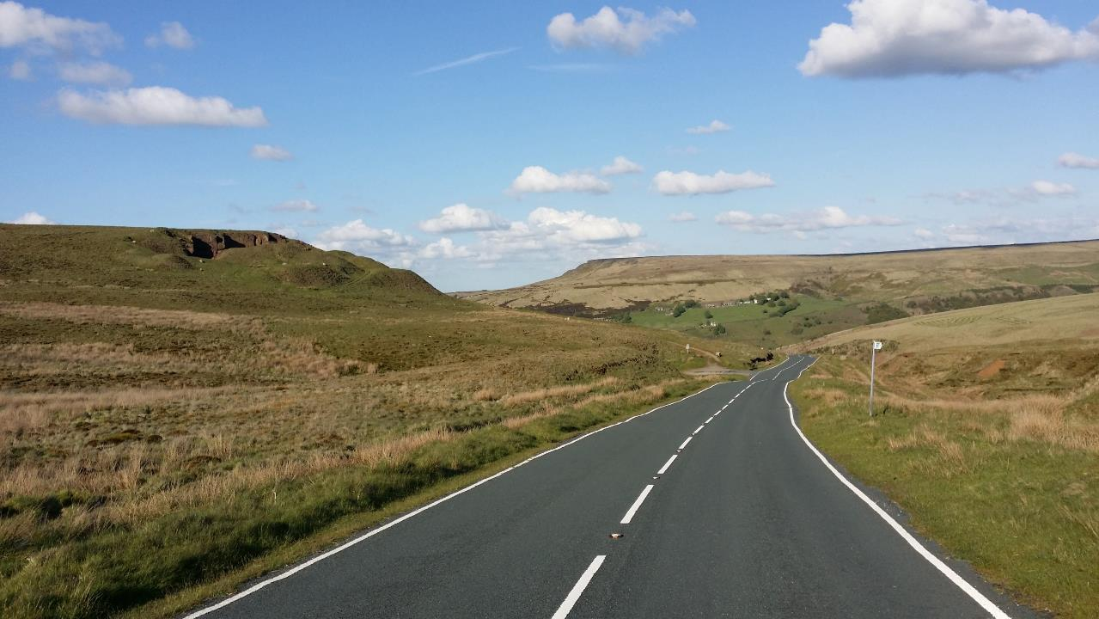
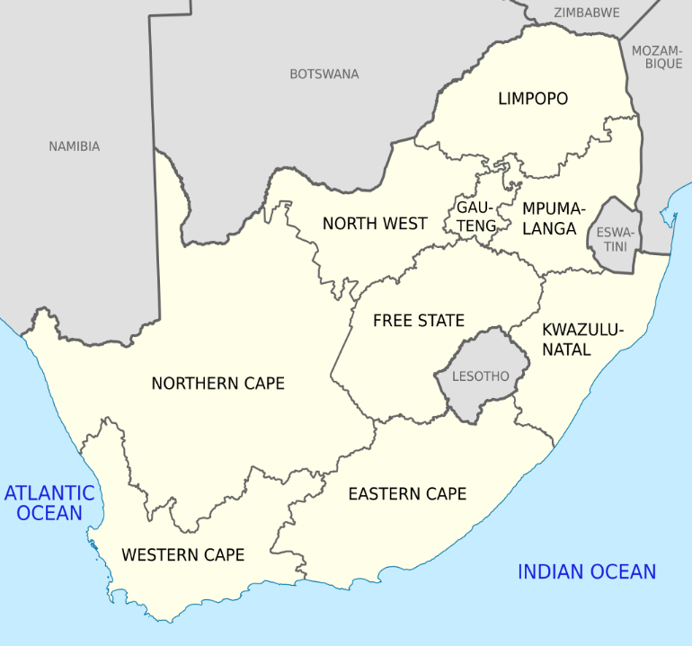




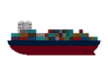








NORTHERN CAPE CORRIDOR
PGM

Slide 25

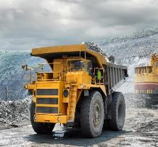
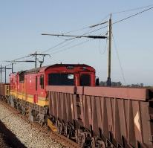



HIGH IMPACT PROJECTS
BOEGOEBAAI PORT & GREEN HYDROGEN (GH2) CLUSTER
Location: Boegoebaai
Estimated Investment Value:
ZAR 700 billion
Project Status:
Pre-feasibility study phase with ambitions to initiate 2025 with construction phase
NAMAKWA SEZ
Location: Namakwa
Investment Value:
ZAR 26 billion
Project Status:
Awaiting investors to locate
UPINGTON INDUSTRIAL PARK
Location: Upington
Investment Value:
ZAR 795 million
Project Status:
Awaiting investors to locate
KATHU INDUSTRIAL PARK
Location: Kathu
Investment Value:
ZAR 1.4 billion
Project Status:
Awaiting investors to take up equity or space
DE AAR LOGISTICS HUB
Location: De Aar
Investment Value:
ZAR 1.2 billion
Project Status:
Awaiting investors to secure site or logistics space
1
DE AAR (LH)
2
3
4
5
6

Slide 26




BOEGOEBERG PORT & GREEN HYDROGEN (GH2) CLUSTER: GAZETTED
PROJECT POSITIONING:
Boegoebaai is approximately 60km north of Port Nolloth and 20km south of the border between Namibia and South Africa in the Richtersveld Local Municipality area. The primary opportunity of the site is the short distance between the coastline and relatively deep water. The location places it relatively close in proximity to rich mining and agriculture sectors compared to other existing ports. It is to be noted that the envisaged Boegoebaai deep water port will be a Greenfields development. The project is the first development of this magnitude to be undertaken by the Province in the last 26 years.
PROJECT UPDATE
With the advent of the new green hydrogen economy, the Boegoebaai Port has provided a platform to transcend its positioning and will enable the province to give effect to the key frontiers proposed in the 2021 SIDSSA. This has sparked the country to focus on developing the precursor Green Hydrogen Strategy with a focus on the Northern Cape towards driving the just energy transition agenda. The Northern Cape Green Hydrogen Strategy was launched to the global community at COP 26 in November 2021, with key articulations that drive its focus. There are key objectives that the strategy seeks to archive and that coupled with the MoA that has been signed between the Northern Cape Government and SASOL to facilitate feasibility studies that would provide certainty on the investment over the next two years.
The project is transitioning with work ensue together with the pathfinder investor to realise the throughputs that has been contemplated in the Northern Cape Hydrogen Strategy.

Slide 27



SA INC POLICY AND STRATEGYJUST ENERGY TRANSITION
LOCAL INDUSTRY & GRID
Conversion of existing industries and grids to use green H₂ as a power source, particularly in sectors that will face drop-off in export demand if they do not decarbonise by 2030.
MINING
& TRANSPORT
EXPORT
Producing mass scale green H₂ and derivatives for export, with flow-over into domestic consumption via Boegoeberg se baai.
Mining, agriculture and logistics need to convert. .
Notes:
Premier this is our focus as the Northern Cape that will fit into the Western SADC Green Hydrogen Corridor and in turn fir into the South African Green Hydrogen Roadmap.

Slide 28



Northern Cape GH2 Development Programme
Boegoebaai SEZ Layout
FUTURE TANK STORAGE
1500HA
Parcels available for investment
USER EXTENT IN m² / ha
Users | Extent (m²) | Extent (ha)
Transnet | 28 820 000m² | 2882 ha
2. Confirmed 1st phase investor | 37 500 000m² | 3750 ha
3. Phase 1 | 5 000 000m² | 500 ha
4. Phase 2 | 4 600 000m² | 460 ha
5. Phase 3 | m² | 830 ha
6. Future GH2 | m² | 3700 ha
7. Future Expansion 01 | m² | 3400 ha
6. Future Expansion 02 | 13000000m² | 1300 ha
7. Future Tank | 15 000 000m² | 1500 ha
Total | 337720000m² | 33 772 ha
CONFIRMED GH2 PRODUCER
3750HA
Proposed Conservancy Area
BOEGOEBERG SEZ PHASING LAYOUT
30000ha enabling the Master Plan

Slide 29

Investment opportunities – capital requirement
How will funding be driven?
  Funding would be driven by various local and global use cases such as industrial power, road transport, shipping, steel manufacturing, mining, agriculture and downstream industries
Establishing the industry will require investment in
  Infrastructure – port, grid, roads, rail, pipelines, city services, dwellings, schools, waste
  Industry – battery park, GH2 gig factory, RE components, fertiliser, beneficiation
  Green Hydrogen – desalination, electrolysis, synthesis, storage
  Renewable energy – land, solar, wind

Slide 30


Designation of NamSEZ
25 May 2023
Cabinet approved the designation of the Namakwa SEZ in Aggeneys in the Northern Cape. The proposed designation is done in terms of the Special Economic Zones Act, 2014 (Act 16 of 2014) and the proposed SEZ is part of the Presidential Investment Drive.
The Namakwa SEZ will unlock mining beneficiation, production of green hydrogen, infrastructure development, renewable energy and agro-procession. These sectors are critical to job creation and economic development of the Northern Cape and the country.
More than R29 billion in investments has already been committed for phase one of the SEZ. These include commitments from Vedanta Zinc (R16 billion), Frontier Rare Earth (R13 billion), Hive Energy (R200 million) and RRS Trade and Investment (R100 million).

Slide 31




UPINGTON INDUSTRIAL PARK
Upington Industrial Park is situated next to Upington International Airport and therefore offers the potential investor the luxury and efficiency of various modes of transport. Through the industrial park programme, investors can enjoy a number of benefits, ranging from a controlled access point to the incentivized provision of infrastructure and relaxed municipal tariffs. Upington Industrial Park forms part of the Northern Cape Industrial Corridor.
The project supports the ideals of the industrialized society and offers the following benefits to the keen investor:
BUSINESS INCUBATOR: Harnessing the necessary skills required by the investor industry’s specific needs and training of SMMEs for future expansion.
SUPPLIER EFFECTIVENESS AND EFFICIENCY: Ensuring improved local capacity, capability, footprint and service levels.
Opportunities exist for investors in Upington Industrial Park in the following sectors:
RENEWABLE ENERGY: Components manufacturing. The majority of solar investors in South Africa’s Renewable Energy Independent Power Producer Procurement Programme (REIPPPP) are located in the Northern Cape. There is an increasing demand for photovoltaic (PV) and concentrated solar power (CSP) in South Africa and Sub-Saharan Africa.
The focus on the renewable energy sector is part of an international trend with many countries setting ambitious targets to be met in coming decades. Renewable energy deployment is one of the goals targeted in the 2030 Sustainable Development Goals (SDGs) by the United Nations (UN). Keen investors are invited to take up space in the UIP for generation, components manufacturing, and any other energy-related activity.
AVIATION: Maintenance, repair, and overhaul facility (MRO) and storage for aircraft. Airports Company of South Africa (ACSA) is looking for investors to locate to prime land, to be involved in the maintenance, repair, and overhaul of aircraft. Storage of these aircrafts is another option given the unique climatic conditions offered by Upington.
AUTOMOTIVE: Vehicle testing and long-term evaluation. Vehicle manufacturers are attracted to high temperatures, rough tracks and good roads. Upington International Airport specializes in providing a service to charter flights for the automotive industry.
AGRO-PROCESSING: The ZF Mgcawu District in which Upington is situated is well known for producing export-quality grapes, citrus, dried fruit such as raisins, and other fruits.
LOGISTICS: Upington’s relationship to the SADC countries and with several modes of transport meeting in the town, make it an ideal logistics hub.
INVESTMENT SECURITY: An investment in Upington will ensure a foothold into SADC and the rest of Africa – enabled with infrastructure, support services and several modes of transport.

Slide 32






Upington Industrial Park
A key industrial node of the NC industrial Corridor
Layout and Phase 1 implementation
Prime space for
industrial activities
380 000m2
available for purchase or lease during phase 1 & 2
Contact NCEDA: 087 086 0350 or
Dawid Kruiper Municipality: 054 338 7014

Slide 33



KATHU INDUSTRIAL PARK
Kathu Industrial Park: The Sishen Iron Ore Company (Pty) Ltd (SIOC) and the Industrial Development Corporation (IDC) have funded various studies to assess the feasibility of developing an industrial park to stimulate sustainable long-term economic development for the Northern Cape region. The envisaged development will attract a variety of tenants delivering industrial goods and services within a synergistic environment supported by centralised services and complemented by a business incubation and training complex. With the mining industry being the largest real economic sector in the Northern Cape economy (based on contribution to GDP), the town of Kathu – located in the Gamagara Local Municipality (GLM) – is the preferred location due to its central proximity to the Postmasburg-Hotazel iron-ore/manganese belt and various established and pending REIPPPP projects. It is envisaged that the Kathu Industrial Park (KIP) serve as a catalyst for accelerated growth of other economic sectors.
The bankability study has not only confirmed extensive interest from businesses with a vested interest in the Northern Cape region (ie potential tenants), but has also confirmed the support of various key stakeholders as well as the commitment of investors and financiers. This development, located on the R380, is easily accessible from the N14 – a major service route between Johannesburg, the West Coast of South Africa and Botswana – and the Kathu airport. The study process has included an assessment of infrastructural requirements and has confirmed integration with GLM planning. The project is considered a key enabler for localized manufacturing initiatives anticipated via the Northern Cape Shared Value Initiative and Impact Catalyst.
TARGETED SECTORS
The KIP targets all economic sectors requiring serviced industrial space in the region, but with the major portion of the initial tenant makeup (study phase uptake) primarily serving the established mining sector, by virtue of the KIP’s central proximity to the Postmasburg-Hotazel iron-ore/manganese belt. The KIP is also well positioned to serve the emerging REIPP sector in the region.
In addition to the ongoing development of business opportunities within the tenant supply chains, it will be the role of the KIP business incubator to expand coverage of the KIP into other sectors. Study phase tenant engagement and commitment to the project has covered all possible prospective tenants, regardless of size or level of development. The KIP development caters for every kind of tenant facilities, from large customized facilities through to smaller economically efficient mini-factories.
PROJECT STATUS:
Bankability Study, Project Development Plan, Environmental Permitting, Land Re-zoning and various scope re-alignment and market studies completed. Investor Engagement Phase substantively completed (including investor term sheets and KIP formational agreements), with provisional commitment secured from IDC, Kumba, SIOC-CDT, Assmang and South32, but with a funding shortfall of R120m still to be resolved prior to concluding KIP Formation and undertaking Phase 1 design development.

Slide 34




DE AAR RAIL LOGISTICS HUB
De Aar Logistics Hub: The Project entails the construction of an inland intermodal system comprising: Container Terminal, Vehicle parking Terminal, Warehouse/Cold room Terminal. The province has focused its priorities (in alignment with the National Development Plan – Vision 2030) and identified priorities to enhance the quality of life of the community. There are inefficiencies in the transport sector that restrict economic growth and job creation because over 80% of freight in South Africa is moved via road. The result of this is poor road conditions which have an impact on product quality, product losses, and substantial expenditure towards vehicle maintenance and related costs. The result is increased operational expenditure for miners and farmers.
The Northern Cape is a major exporter of table grapes, fruit, and meat and is responsible for much of the cattle, sheep, and goat farming in the country. Long distances and poor access to markets and storage facilities are limiting profitability for farmers. Small-scale and emerging farmers are excluded from exporting due to the lack of critical mass and other dynamics such as access to markets and financial resources. The mining sector has expressed similar concerns. Approximately 60% of the commodities from large producers are already moved from Hotazel by rail through the province via De Aar or Bloemfontein to Port Elizabeth. Various other commodities are moved via rail through the town of De Aar, of which the most notable are cement from the domestic market, coal, and lime, and containers holding general cargo and automotive components. Train drivers and locomotives are changed in De Aar which supports the concept of De Aar becoming a consolidation point for freight to ensure migration from road to rail due to its location and connectivity. The De Aar Logistics Hub serves as the first step for the long-term solution sought by the Northern
ECONOMIC IMPACT
Container terminal – consolidation of freight
Agricultural warehouse Storage facilities Vehicle storage yard.
Potential commodity mix:
The Northern Cape has many commodities that can be traded and transported via the De Aar Logistics Hub which could serve as a catalyst for local and regional economic development.
POTENTIAL
COMMODITY
MIX & VOLUMES

Slide 35






THANK YOU
The prime investment destination offering you the best ranging from Mother Earth to the galaxy......

