Slide 1

The Digital Evolution.
Tourism Investment Forum Africa

Slide 2


Slide 3
About Digicall
The Digicall Group has been delivering world-class outsourced and incident management services to our valued clients across diverse industries, globally, since 2003.
Our history is characterised by sustained and acquisition-led growth, and everything we do is enabled, integrated, and improved by our best-in-class technologies, our specialised and automated business systems, and our outstanding people.

Slide 4













Global Footprint
UK
Digicall Call Centre Birmingham
Africa Assist UK Private ambulances Home visit doctors Dentist network
Global excel/chargecare cost containment partner for eurpoe
main tourism centres
EUROPE
In country agents throughout europe 4 specialist air ambulances
TURKEY
Air ambulance
Clinics, Doctors, Hospitals Cost containment
CHINA
Central 24 hour call
Hospitals, Clinics, ambulances and air ambulances
USA & CANADA
Three Major Cost Containment Companies
Significant Hospital and Medical Provider Discounts
UAE
In country agents Direct hopsital agreements
CARIBBEAN
Cost Containment Agent specialising in the Caribbean
INDIA
Medical assistance Air ambulances Ambulances Repatriation services
THAILAND
Air ambulance and emergency services throughout Thailand, Cambodia and Myanmar
AFRICA
Africa Assist 27 In country agents
1750 Service provider contracts
Hospitals Private ambulance services
GP’s
Helicopters Air ambulance services
CENTRAL & SOUTH AMERICA
Assistance and cost containment agents
Air ambulances Ground ambulances Hospital network Doctor network
24 Hr hour team travel agent In house medical repatriation
AUSTRALIA
Digicall Assist

Slide 5


Slide 6

 | > 73 000 |  | > 265 000 |  | > 132 000
 | Property Assessing and Repair Claims |  | Motor and Building Glass Claims |  | Geyser and Plumbing Claims
 | > 305 000 |  | > 20 000 |  | > 4 305000
 | Assistance Services Road and Home (SA and AUS) |  | Outsourced Claims Processing and Fulfilment |  | Customer Care Interactions and Surveys
 | > 29 000 |  | > 141 000 |  | > 504 000
 | MOBILE CONTRACTS Outbound Sales |  | Payslips and Tax Certificates |  | 70 AGENTS Sales and Distribution
1 544 FTEs SA
1 626 FTEs UK
Fast facts
6000 Employees Worldwide
Credit Management

Slide 7
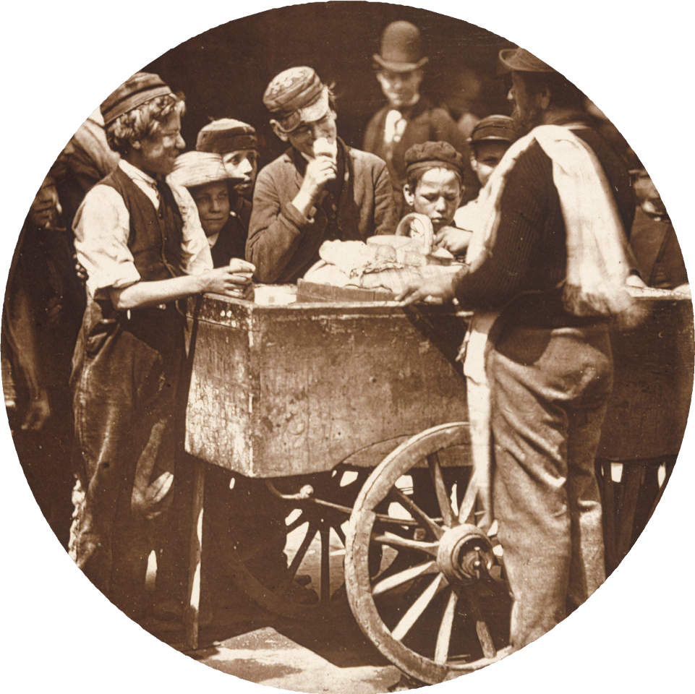
The evolution of the ice trade

Slide 8
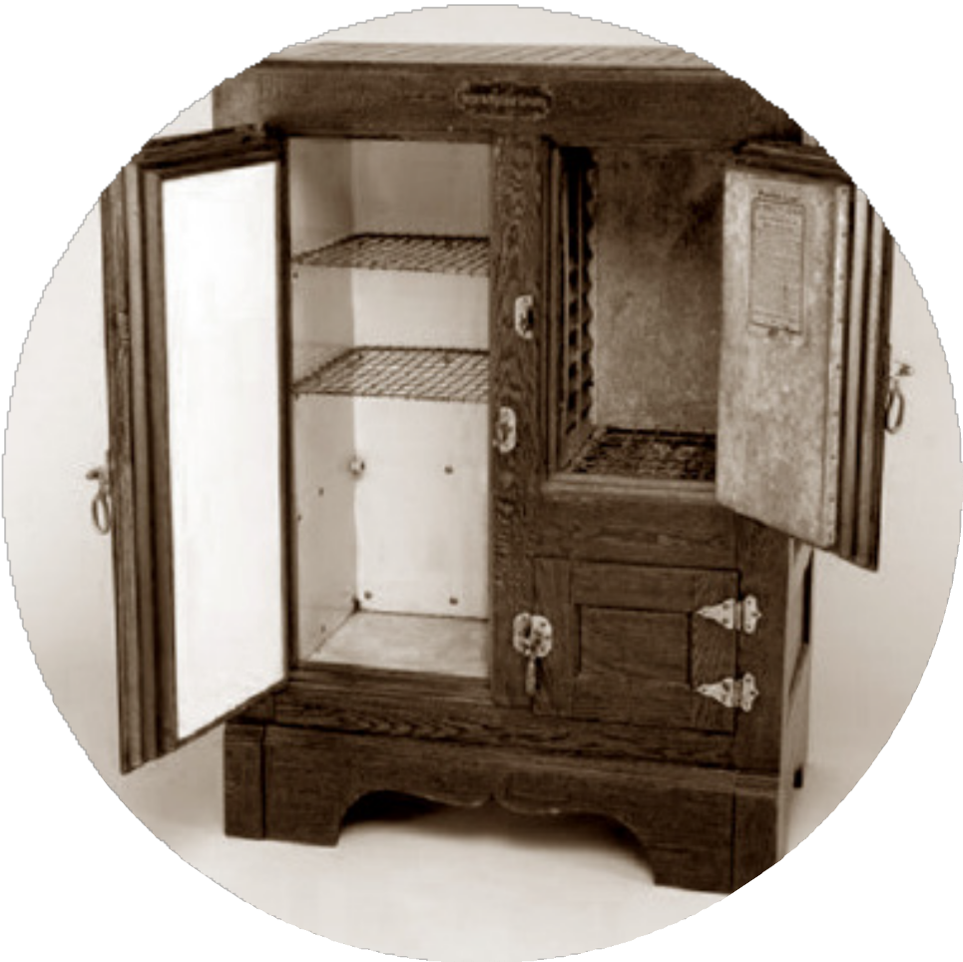
The evolution of the ice box

Slide 9

The evolution of the smart fridge

Slide 10

The evolution of fresh produce delivery

Slide 11

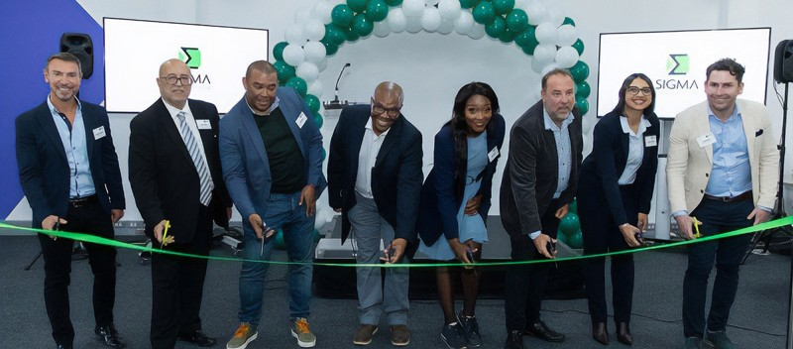
First call centre in the township of Mitchells Plain
Cape Town

Slide 12
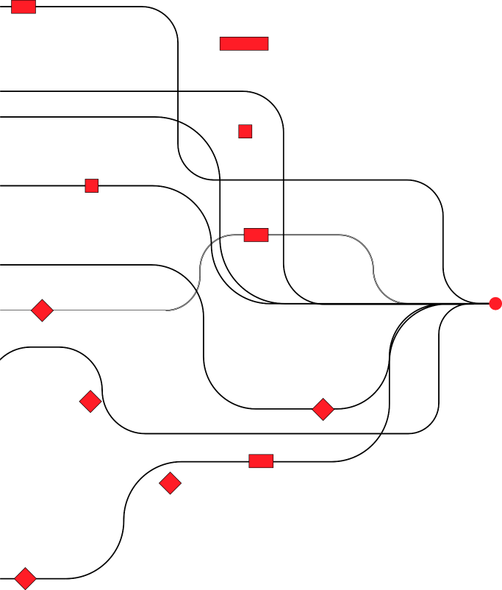
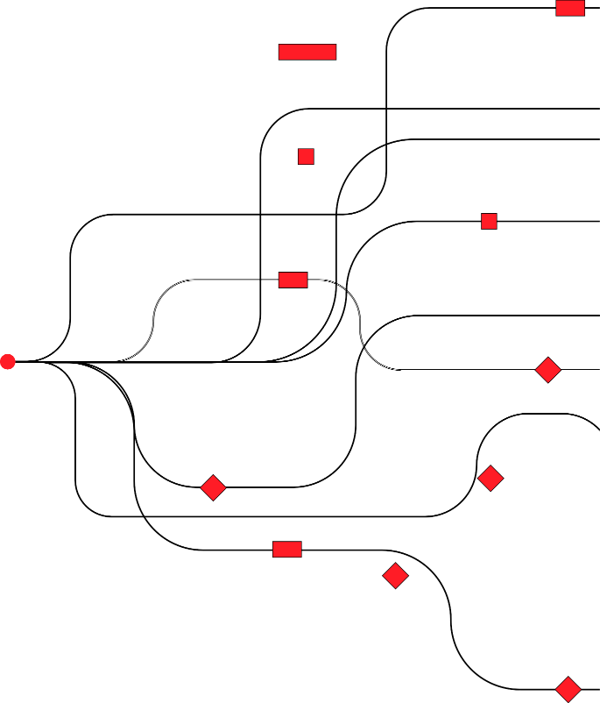


How do we converge and bundle our services?

Slide 13
Convergence
to create new Global currency
Service Business Building rails for trade

Slide 14
Facial Recognition
Border patrol, Accommodation check-in
CITY OF CAPE TOWN Transport information Centre

Slide 15


































Augmented Reality Digitising existing artefacts for commercialisation
Liliesleaf Museum Nelson Mandela’s Arrest warrant NFT auctioned for nearly R2m

Slide 16
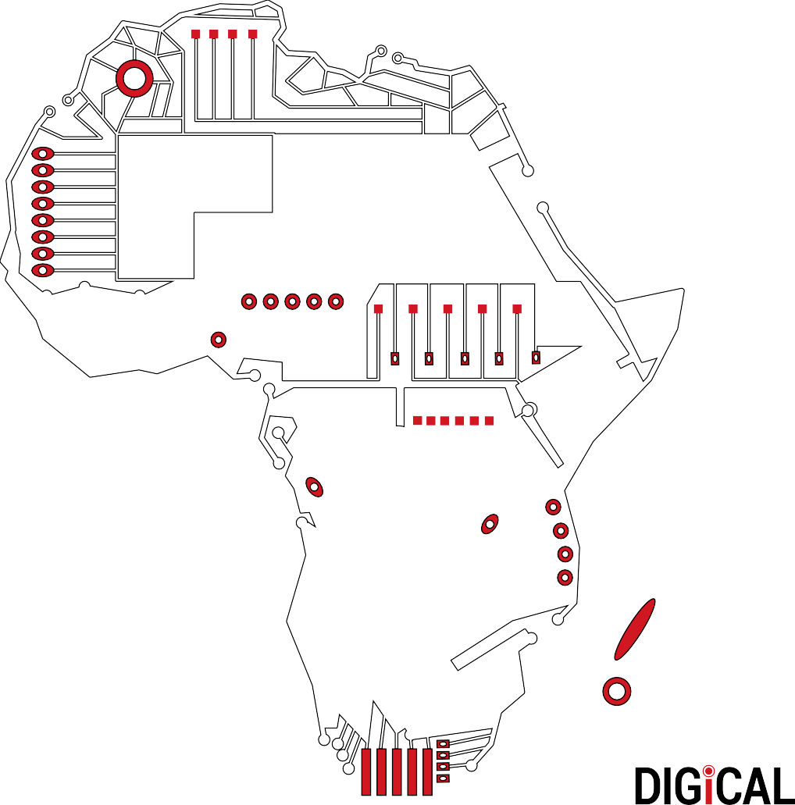

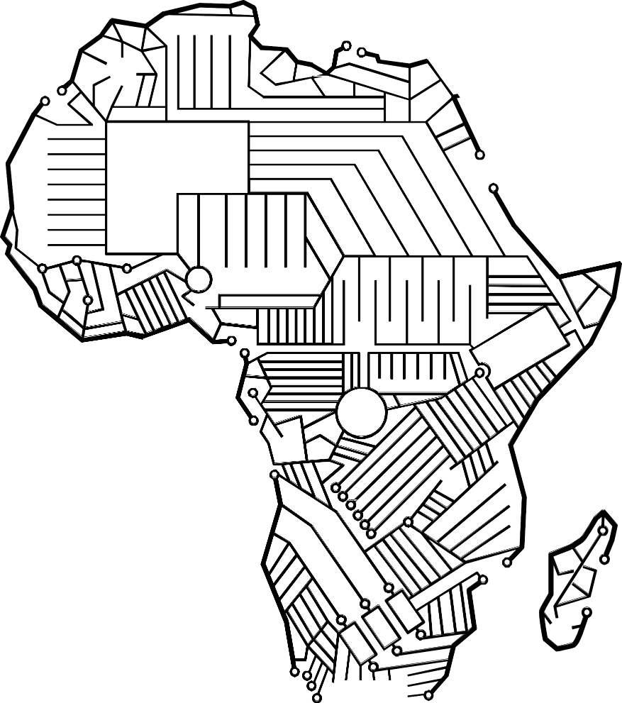
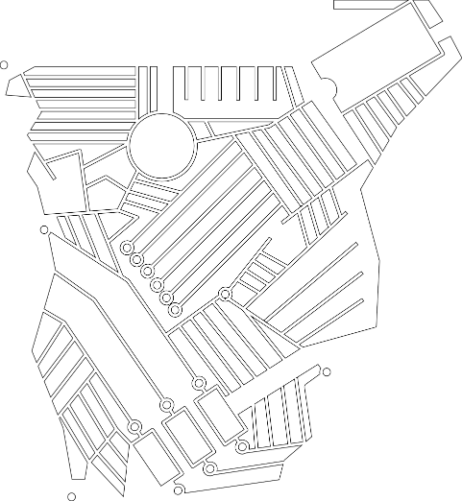
We, As Digicall Want to
Co-create.
Create new markets
Support digital enablement initiatives

Slide 17









You don’t need a Digital strategy.
You need a business strategy for the Digital age.
DIGICALL Group
Your Enablement Partner

Slide 18
Thank You.
www.digicallgroup.co.za

