Slide 1

INVESTMENT OPPORTUNITIES:
MTPA PROTECTED AREAS

Slide 2
INTRODUCTION
The Mpumalanga Tourism and Parks Agency (MTPA) is the Management Authority for the provincial nature reserves under the Mpumalanga Government.
Twenty-six (26) are declared nature reserves, and 17 are actively managed.
Seven of the provincial nature reserves, by virtue of their natural assets, size and/or location offer viable opportunities for the development of tourism enterprises, these are:-
  The Blyde River Canyon which includes Mariepskop, Songimvelo, Manyeleti, Andover, Sterkspruit, Mdala and Mkhombo Dam Nature Reserves.
The MTPA is looking for potential investors who may be interested in investing in these nature reserves.

Slide 3

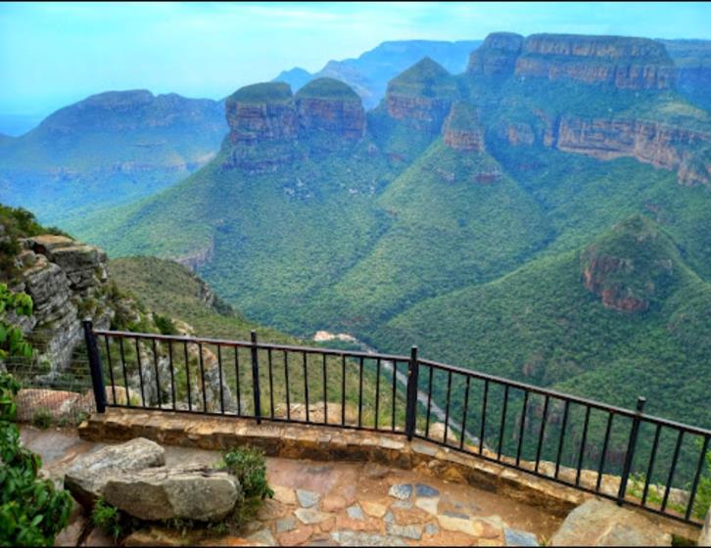
BLYDE RIVER CANYON NATURE RESERVE
The Blyde River Canyon is a 26km long canyon located in Mpumalanga, South Africa. It is one of the largest and deepest green canyons in the world.

Slide 4
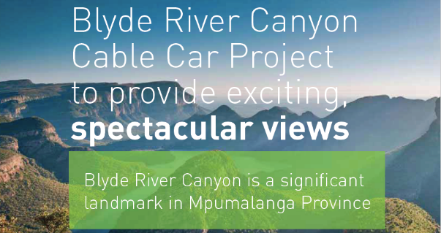
Blyde River Canyon Cable Car Project
Mpumalanga is inviting interested investment partners to build the Blyde River Canyon Cable Car, which will transport tourists from the top of the Blyde River Canyon to the peninsula below. The cable car will provide an exciting experience and spectacular views over and around the Blyde Canyon. This unique investment, estimated at R300 million

Slide 5
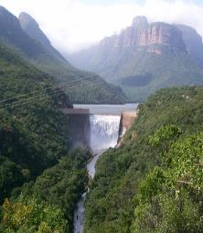
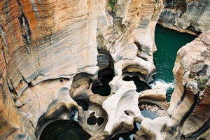
PIPELINE OF CATALYTIC PROJECTS AT BLYDE RIVER CANYON NATURE RESERVE
The entity has a pipeline of catalytic projects, for which Feasibility Studies and Environmental Impact Assessments (EIAs) were completed.
In addition to the Cableway Project – other investment opportunities at Blyde include:
The Bourke’s Luck Potholes Hotel – to be built near the natural water wonder which is Bourke’s Luck Potholes - a major tourism attraction in the Mpumalanga Lowveld. The facility is proposed to be an 80 bed hotel, with rooms orientated down the canyon with remarkable views. PPP/ JV / BOT - ZAR 284 million.
The Blyde Hydropower Station to generate renewable energy.
The project takes advantage of the existing Blyde River dam, which is suitable for such a power station. PPP/ JV / BOT - ZAR 63 million

Slide 6
OTHER INVESTMENT OPPORTUNITIES AT BLYDE RIVER CANYON NATURE RESERVE INCLUDE:
Boat Cruise Operators- the MTPA is looking for two investors to operate and manage Boat Cruises and other amenities such as a Kiosk at the beautiful Swadini Dam Concession Opportunity, JV’s also encouraged- ZAR 2 million.
Floating Restaurant Operator- the MTPA is looking for an investor to design, operate and manage a 24 seater Floating Restaurant at Swadini Dam Concession Opportunity, JV’s also encouraged - ZAR 3 million.
Paradise Camp operator - the MTPA is looking for an investor to upgrade, operate and manage the scenic Paradise Camp set in a tranquil location with unique geological rock formations, the facility can offer up to 24 beds, the camp which is ideal for nature-based activities, with a beautiful gorge down below it, is close to the Gods Window. Concession Opportunity, JV’s also encouraged/ BOT - ZAR 20 million.
Clearstream and Waterval 3day Hiking Trail operator - the MTPA is looking for an operator to operate and manage the 3day hiking trail with two rustic accommodation facilities that can offer up to 30 beds. The trail is close to the Gods Window and Paradise Camp in the Blyde River Canyon Nature Reserve. Concession Opportunity, JV’s also encouraged- ZAR 1 million.

Slide 7
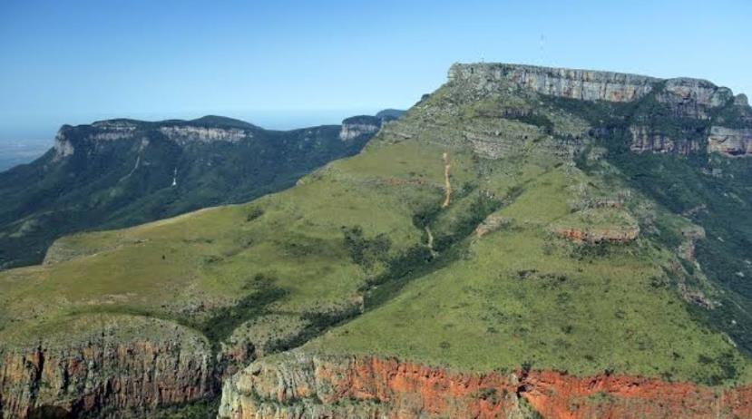
MARIEPSKOP
Mariepskop Mountain is one of the highest peaks in the northern Drakensberg, and the highest point of the Blyde River Canyon. It stands tall on the eastern side of the Drakensberg Escarpment, with its back to the Blyde River Canyon. Ascend the mountain and you will stand 1 945 metres above sea level, the Indian Ocean and even Maputo visible on a cloudless day. To reach the top there is a steep pass between Klaserie and the ridge of the Drakensberg.

Slide 8
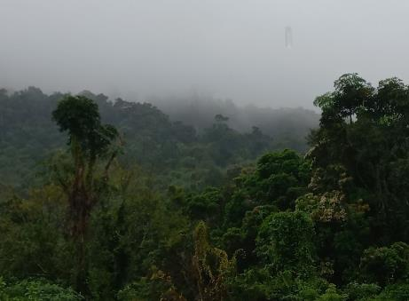
INVESTMENT OPPORTUNITIES AT MARIEPSKOP
The route to the mountain is very scenic, as it offers you the experience of driving through a tropical rain forest. You may come across various plains game and leopard on the way up. The mountain peak is very rocky but it boasts a wide variety of plant species.
Plans for development involve:
Upgrading the old Military Base into a hotel, which can take more than 100 people.
The entity is also looking for investors to design a glass restaurant that can take more than 100 people.
Feasibility studies and EIA studies have not yet been conducted on the investment opportunities

Slide 9
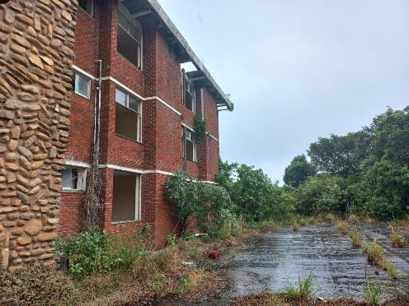
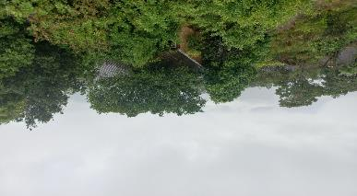
MORE INVESTMENT OPPORTUNITIES AT MARIEPSKOP
Future plans involve:
Upgrade of Madibabakone Resort Node (Welgevonden), the resort can take more than 200 people
Upgrade of two chalets that can accommodate 6 patrons each
Upgrade of a guesthouse that can take up to 10 people
Feasibility studies and EIA studies have not yet been conducted on the investment opportunities

Slide 10
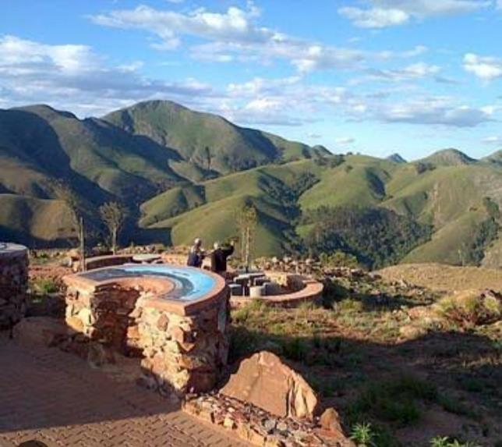
BARBERTON MAKHONJWA MOUNTAIN WORLD HERITAGE SITE (BMM-WHS)
The Barberton Makhonjwa Mountain Land is the first UNESCO World Heritage Site in the province. Mpumalanga, which shares borders with Gauteng and Limpopo, has always been one of South Africa’s prettiest provinces in terms of dramatic landscapes. And these mountains are just one more dazzling gem in this treasure chest.

Slide 11
INVESTMENT OPPORTUNITIES AT BMM-WHS
Proposed development of a 144 beds hotel at the high intensity leisure site with activities such as Restaurants, shops, education centre, picnicking and braais areas.
Development of a Lodge with a maximum of 48 beds at the low intensity leisure site with amenities such as Restaurants, shops, education centres, picnicking and braais
A development of a Resort with a maximum of 250 beds at the peripheral tourism development area with amenities such as Swimming pools, sport facilities, Theme park, Restaurants, shops, education centres, picnicking and braais, etc.
Feasibility studies and EIA studies have not yet been conducted on the investment opportunities.

Slide 12
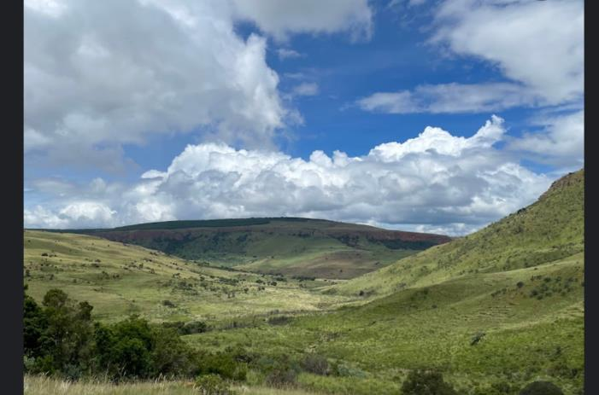
STERKSPRUIT NATURE RESERVE
Sterkspruit Nature Reserve lies right next to the scenic Long Tom Pass, on the Sterkspruit River, about 45 minutes from Dullstroom. It is stocked with rainbow trout, surrounded by the glorious combination of highveld grassland, wooded stream banks, forested kloofs and quartz cliffs.

Slide 13
INVESTMENT OPPORTUNITIES AT STERKSPRUIT NATURE RESERVE
CANTILEVER WALKWAY
The cantilever sky walkway is to be a focal feature of the reserve that people can look forward to, along the trail.
It allows for an unnatural and exciting perspective of the view, adding depth to
the use of the natural environment.
We see the cantilever walkway through the lens of incremental development, meaning the structure does not have to be constructed in the foundation phases, but rather as time goes. PPP/ JV / BOT - estimated cost ZAR 100 million.
Feasibility studies and EIA studies have not yet been conducted on the investment opportunities.

Slide 14
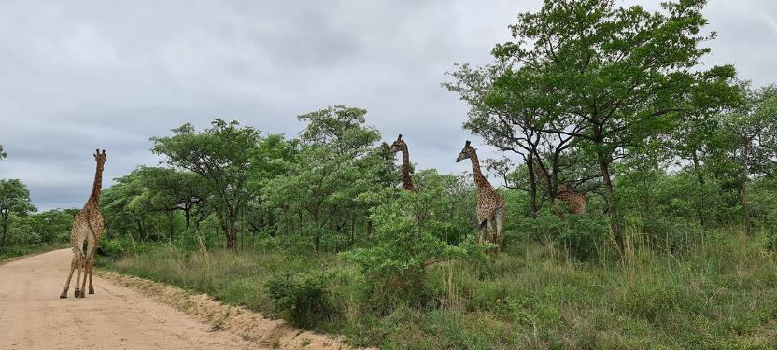
ANDOVER NATURE RESERVE
Andover Nature Reserve is an unspoiled Nature Reserve, situated amidst the Kruger National Park and Sabi Sands.
The 7 000 hectares reserve is home to zebra, giraffe, kudu, bushbuck, and other small antelope. The highlight though is the occasional sighting of rhino, buffalo and lion - they tend to visit from neighboring nature reserve, Sandringham, spend a few days within Andover and then return to their side of the fence.

Slide 15
ANDOVER NATURE RESERVE
Andover is considered an excellent example of a “truly wild” and undeveloped area that gains from its proximity to the Kruger as migratory wildlife follow routes they have followed for years, ignoring manmade boundaries.
Current Accommodation Facilities:
The reserve does not cater for huge numbers of visitors. It has four Rondavels ideal for couples, it also has a guesthouse that accommodates four people and a caravan park for eight people – making it an attractive option for those who enjoy privacy and solitude.
INVESTMENT OPPORTUNITIES AT ANDOVER NATURE RESERVE
DAY VISITORS’ AREA - PICNIC SITE
An opportunity to develop a new day visitors’ facility in the form of a concession where the service provider would Built. Operate, Maintain and Transfer (BOMT).
This would entail developing a swimming pool, braai area, ablution block with change rooms and a lapa.
DEVELOPMENT OF NEW CHALETS X 5
DEVELOPMENT OF CAMPING SITE at the Hippo dam.

Slide 16
INVESTMENT OPPORTUNITIES AT ANDOVER NATURE RESERVE
TENTED CAMP:
The aim of the Tented Bush Camp is to give patrons an experience of accommodation right inside the bush with a game viewing sight every morning.
PPP/ JV / BOT are encouraged - estimated cost ZAR 20 million.
Feasibility studies and EIA studies have not yet been conducted on the investment opportunities.

Slide 17
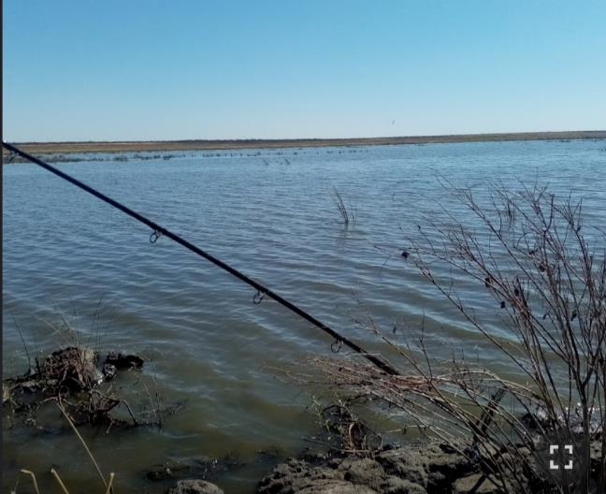
MDALA AND MKHOMBO NATURE RESERVES
Mdala Nature Reserve is situated in the Mpumalanga Province, approximately 65 km north of Bronkhorstspruit. It covers approximately 8 600 ha. The reserve ‘s mountains and plains are covered with savannah vegetation and game, which creates an exciting bush veld atmosphere. It is situated in a summer rainfall area with warm to very hot summer and moderate winter. Rainfall mainly occurs in the period from November to March.
Mkhombo Nature Reserve: The terrain of the reserve varies from relatively flat plateaus on the higher lying areas, through steep cliffs and a variety of slope types to some valleys and relatively flat-to-flat valley bottoms. The weather condition is a summer rainfall area with warm to very hot summer and moderate winter.

Slide 18
INVESTMENT OPPORTUNITIES AT MDALA AND MKHOMBO NATURE RESERVES
.
The Mkhombo and Mdala Nature Reserves, which are neighbouring nature reserves, collectively have the potential to appeal to, and attract a wide range of tourists, and offer diverse tourism products and experiences,
Business Opportunities include:
Outsourcing and upgrading of Mkholwane Lodge,
Construction of a Conference Centre at Zandspruit area.
Upgrading of the Mdala education centre to a multi - purpose centre.
Upgrade of four guest houses to include en-suites.
PPP/ JV / BOT encouraged- estimated cost ZAR 100 million.
Feasibility studies and EIA studies have not yet been conducted on the investment opportunities

Slide 19
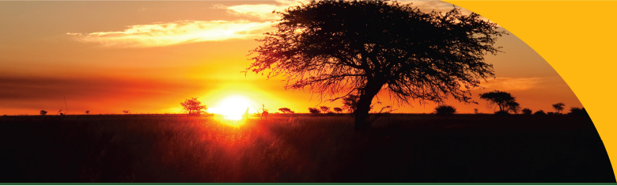


THANK YOU
DANKIE
REA LEBOHA
HI NKHENSILE
SIYATHOKOZA SIYABONGA
NDOLIVHUAA
ENKOSI

