Slide 1
Transnet – Tourism, Hospitality and Heritage
Tourism Investment Forum Africa
08/06/2023

Slide 2

Who Are We
Regional Integration
In line with our strategy, Business Development serves to increase the revenue-generating capability of Transnet in existing markets, and through diversified business growth initiatives.
This is achieved through collaborating and partnering with the private sector and other stakeholders to grow the business in a safe, cost-effective and efficient manner that optimizes social, economic and environmental value.
Partnering
Increase intra Africa trade by promoting regional integration and collaboration.
Partner with the Private Sector for growth.
Modal Shift
Asset Utilisation
Accelerate the modal shift from road to rail within South Africa and cross-border.
BD
Maximize revenue generation capacity through optimizing asset utilization.
Reducing Cost
Reduce the cost of doing business for our customers.

Slide 3




Tourism, Hospitality and Heritage
Positioned to grow Transnet’s tourism footprint in the luxury rail, and heritage tourism segments Locally, Regionally and Globally.
Commercialisation of heritage assets, and the exploitation thereof through tourism for revenue generation purposes and reputational gain.
Expansion of hospitality offerings, such as the repurposing of Transnet’s heritage assets, event planning (customer events), and restoring hospitality assets to world-class standard.
Building a sense of unity and belonging while creating a better understanding of previous generations, and promoting local economic development.

Slide 4

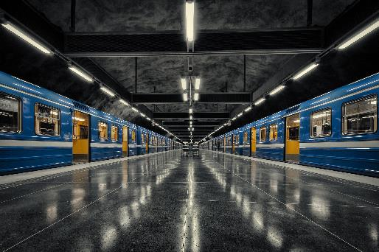

The Blue Train – Luxury on Rail
Unsurpassed, world-renowned, luxury travel onboard Africa’s finest and oldest leisure passenger experience on rail. Ever-changing views of the countryside, accompanied by personalized butler service.
Seeking opportunities and partnerships to expand our operations into neighbouring countries (Botswana, Namibia, Zimbabwe, Zambia, and eSwatini).
Impending expansion will require partnerships with tourism bureaus, tour operators, resorts, hotels and other tourism experiences within these countries.

Slide 5
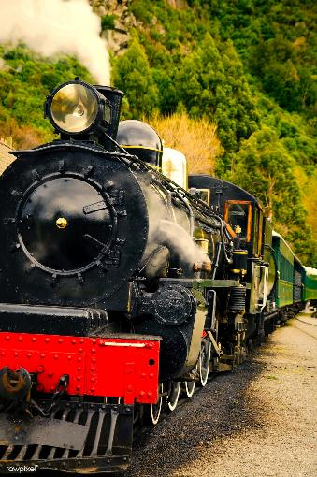


Steam Trains & Branch Line Concessions (Tourism)
South Africa is an ideal investment destination for heritage railway tourism due to the high number of interesting and scenic routes that our railway networks transverse.
Partnering with the private sector to revitalize under-utilised heritage assets and branch lines for heritage tourism operations.
Concessions and investment opportunities exist on the George – Knysna Line (George), and PE Narrow Gauge (Apple Express – Gqeberha).
Heritage passenger trains – leasing of Transnet’s heritage assets (steam locos and coaches) for tourism purposes.

Slide 6

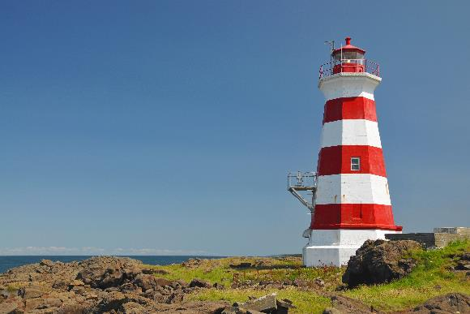


Adaptive Reuse – Heritage Buildings
Commercialisation of heritage assets, and exploitation thereof through tourism for revenue generation purposes and reputational gain.
Adaptive reuse of heritage buildings (railway stations, lighthouses, and functional spaces) for restaurants, overnight accommodation, guided tours, and other tourism ventures.
Filming Locations – Usage of Transnet heritage assets as filming locations for movies, series and other content.
This Photo by Unknown Author is licensed under CC BY-SA

Slide 7



Museums, Sites, and a Library
“Museopreneur” – sustainable cultural institutions for the effective management and conservation of heritage assets for the benefit of society.
Investment in our cultural institutions, and repositioning them as tourist attractions in George, Western Cape and Kimberley, Northern Cape.
Expanding our hospitality offerings – venue hire (conferences, events and markets); and opening certain operations up to investors and partners (eventing services, dining, and equipment hire).
Diversified museum operations through offering
office and boardroom rentals for engagements,
and curated experiences.

Slide 8
How Can We Collaborate?
Government to Government Agreements
Joint Ventures and/or Partnerships
Leveraging Project Development Funding
Joint Marketing Initiatives

Slide 9
THANK YOU

