Slide 1

SOUTH AFRICAN TOURISM INVESTMENT OPPORTUNITIES & PROJECTS
KENNY S. HLELA, DIRECTOR: TOURISM INVESTMENT COORDINATION
INAUGURAL TOURISM INVESTMENT FORUM AFRICA, AFRICAN VINEYARD HOTEL IN KANONEILAND, NEAR UPINGTON, NORTHERN CAPE
7 JUNE 2023

Slide 2
Table of Contents
Location
South Africa in Context
Background to the Pipeline
Business Case for Tourism
Components of Destination Supply
Drivers of tourism growth in South Africa
Project Summaries
  Hole in the Wall Resort, Eastern Cape Province
  God’s Window Skywalk, Mpumalanga Province
  Bakubung Smart City Development, North West Province
  Orpen Kruger Lodge, Mpumalanga Province
Foreign Investment and Taxation
Selected Investment Incentives

Slide 3
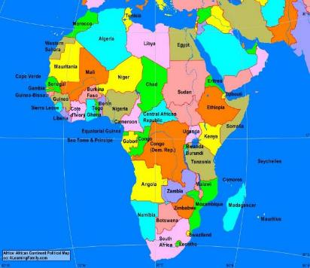
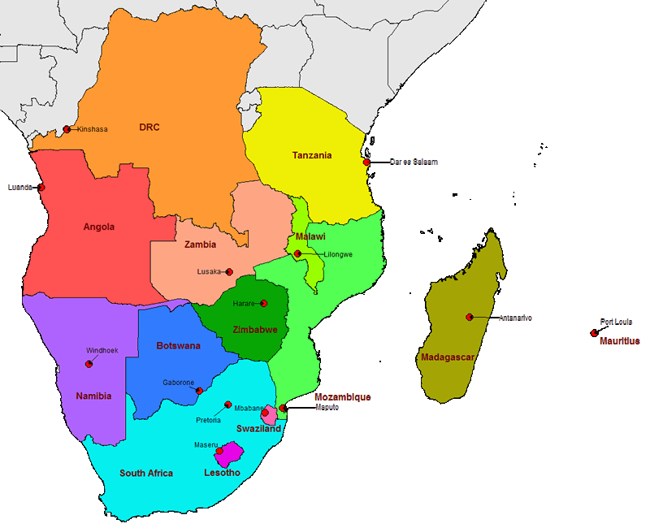
Geographic Location (1)
AFRICA SADC REGION
Africa has 55 countries with a total population of 1,256 billion.
Southern African Development Community (SADC) has 15 countries with a total population of 277 million.
Source: United Nations and the South African Development Community

Slide 4
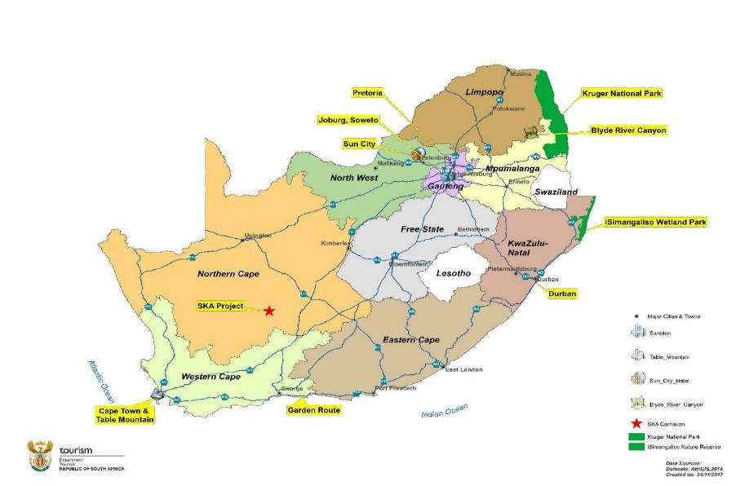
Geographic Location (2)
AFRICA SADC REGION
Africa has 55 countries with a total population of 1,256 billion.
Southern African Development Community (SADC) has 15 countries with a total population of 277 million.
Source: United Nations and the South African Development Community

Slide 5
South Africa in Context
Located at the southern tip of Africa, South Africa is one of the most promising emerging markets globally.
Positive demographic profile, with expanding middle-class who’s spending power is growing.
South Africa remains a top tourism destination for visitors from across the globe, owing to its diverse offerings and world-class infrastructure
Source: World Bank
DEMOGRAPHICS | ECONOMIC INDICATORS
Land area: 1,219 million sq.km | Currency: South African Rand (ZAR) Exchange Rate: 1 US$ = 19.22 ZAR 1 EUR = 20.53 ZAR
Capitals: Pretoria (Administrative), Cape Town (Legislative) & Bloemfontein (Judicial). | Total GDP Africa Ranking (2021 est.): US$ 440.83 bn – Nigeria US$ 419.01 bn – South Africa US$ 404.14 bn – Egypt
Population (2022 Est.) 1. Nigeria – 218 million 3. Egypt – 106 million 6. South Africa – 61 million | GDP per capita: (2020 est.) US$ 5,655 – South Africa US$ 3,569 – Egypt US$ 2,097 – Nigeria

Slide 6
What we do
Background
South Africa through the Department of Tourism manages a Pipeline of Nationally Prioritised Tourism Investment Opportunities focusing on projects with the following attributes:
  High impact projects with multiplier effects, i.e. that will be able to crowd in further investment including community benefits.
  Projects with no fundamental problems such as disputes on ownership, unresolved land claims, etc., which could undermine confidence in the project.
  Projects with one or more core attraction(s) within the area.
  Projects in underdeveloped areas with high tourism potential.
  Long-term lease on the land.
  Community buy-in.

Slide 7
Business Case for Tourism
Tourism provides enormous potential to create linkages with other sectors and dynamise other sectors of the economy – agriculture, manufacturing and services. Tourism generates demand and production in other sectors of the South African economy.
Tourism White Paper, 1996

Slide 8

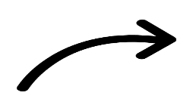


















Components of Destination Supply – Tourism as a System
Attractions/Activities
[What to see and/or do?]
Awareness
[Do locals see the value of tourism & tourists?]
Access
[How to get there?]
Amenities
[Are there services for tourists?]
Accommodation
[Where to stay?]

Slide 9
Drivers of Tourism Growth in South Africa
Heritage and cultural tourism.
Wildlife and safari (eco-tourism)
Sports tourism and MICE
Beach tourism
Health and wellness tourism
Shopping

Slide 10
Value Proposition to Investors
Projects with a strong community beneficiation element.
  Directly in the project or procurement of laundry services, agricultural goods, etc. from the neighbouring communities.
Partnership with a credible operator.
  Preferably an operator with equity (“skin in the game”) or providing guarantees in terms of visitors to the establishment (a performance based partnership agreement)
Projects valued at R100 million or more
  Mainly for projects destined for the Public Investment Corporation and/or Foreign Investors.
Long-term lease on the land
  10-years or more. A minimum of 20 years is more bankable.

Slide 11
Investment Ready Projects
Name of Project | Estimated Cost | Location
Hole in the Wall Resort Development (Incopho Coastal Developments) | R314.5m (US$60.4m) Investment need: 40% equity | Hole in the Wall Near Coffee Bay, Eastern Cape Province
God’s Window Skywalk (Motsamayi Tourism Group) | R500m (US$26.01m) Investment need: 40% - 50% equity. | Near Graskop in the Blyde River Nature Reserve, Mpumalanga Province
Bakubung Smart City Development | R1.2 billion (US$62.43m) Investment need: 40% equity | Ledig near Sun City, Resort, North West Province
MontDor Orpen Lodge (MonDor Clarens) | Phase 1: R19m (US$0.998m) for 10 chalets Phase 2: R15m (US$0.780m) for10 additional chalets to complement the existing ones – possible grant funding on behalf of the community. Phase 3: R95m (144-room hotel style development). Investment Opportunity: 40% Equity on Phase 3 | Kruger National Park Orpen Gate, Bushbuckridge LM, Ehlanzeni DM, Mpumalanga

Slide 12
PROJECT TITLE/NAME | HOLE-IN-THE-WALL RESORT DEVELOPMENT
AUTHORITY | Incopho Coastal Developments (Pty) Ltd
LOCATION | Hole in the Wall near Coffee Bay in the OR Tambo District Municipality, Eastern Cape Province
TYPE OF DEVELOPMENT | Accommodation and Conference Facilities
PROJECT DESCRIPTION | Bay with a huge detached cliff that has a giant opening carved through its centre by the waves. The development will include the following: Phase 1: 100-room hotel (3 or 4 star) Phase 2: Self-catering accommodation (60-rooms) Day Visitors Facilities which include restaurant, Lounge, Health Spa, Fitness Centre A 300 seater conference facility
APPROXIMATE COST | R314.5m (US$16.36) – Proposed Project Funding Structure: – 1. IDC at 60% = R188.7m (US$9.3 million - senior debt), 2. Incopho Coastal Development at 7% = R22.01m (US$1.14m), 3. Investment required at 33% of the project cost: R103.78m (US$ 5.3m). Jobs: 86 permanent (direct) and 200 during construction
CURRENT STATUS | All planning processes are complete and the project is ready to start. Letter of intent signed with Marriot International as the preferred operator. Lease agreement with the Department of Agriculture, Land Reform & Rural Development signed (custodian of rural and/or communal land with no title deed).
TYPE OF PARTNERSHIPS | Equity partnership at 33% of the project cost. Target return on equity of 13%. Leverage funding of (debt) 55% (plus 5% grant) of the capital cost is to be financed via the IDC (a South African development finance institution with a mandate to invest across the continent) on commercial terms. Currently the developers have committed approximately US$ 142 000 for the project establishment phase. Certain portion of the consortium contribution will come from govt contribution in the form of a grant.
CONTACT DETAILS | Mr Bossie Bosman, Director: Incopho Coastal Developments, Cell: +27 82 699 8705 & E-mail: jongani@mweb.co.za Ms Katlego Mphahlele, Senior Dealmaker: IDC, Tel: +27 11 269 3101 & Email: katlegom@idc.co.za
Notes:
The resort will be located 94 kilometres from Mthatha and 288 kilometres from East London and aaccess will be through the newly upgraded N2 road from the Mthatha Airport

Slide 13
PROJECT TITLE/NAME | HOLE-IN-THE-WALL RESORT
AUTHORITY | Incopho Coastal Developments (Pty) Ltd
LOCATION | Hole in the Wall near Coffee Bay in KSD Local Municipality, Eastern Cape Province
TYPE OF DEVELOPMENT | Accommodation and Conference Facility
PROJECT DESCRIPTION | Bay with a huge detached cliff that has a giant opening carved through its centre by the waves. The development will include the following: Phase 1: 100-room hotel (3 or 4 star) Phase 2: Self-catering accommodation (60-rooms) Day Visitors Facilities which include restaurant, Lounge, Health Spa, Fitness Centre A 300 seater conference facility
APPROXIMATE COST | Project Funding Structure: ZAR271 937 255 [US$ 14 941 607] – 1. IDC at 60% (ZAR163 162 353 [US$ 8 964 964] (senior debt), 2. Incopho Coastal Development at 7% (ZAR19 035 607 equity – US$ 1 045 912), 3. Investment required at 33% of the project cost: ZAR 89 739 294 [US$ 4 930 730]
CURRENT STATUS | All planning processes are complete and the project is ready to start. Letter of intent signed with Marriot International as the preferred operator. Lease agreement with the National Government signed (custodian of rural land with no title deed).
TYPE OF PARTNERSHIPS | Equity partnership.
CONTACT DETAILS | Mr Bossie Bosman, Director: Incopho Coastal Developments, Cell: +27 82 699 8705 & E-mail: jongani@mweb.co.za Ms Katlego Mphahlele, Senior Dealmaker: IDC, Tel: +27 11 269 3101 & Email: katlegom@idc.co.za

Slide 14
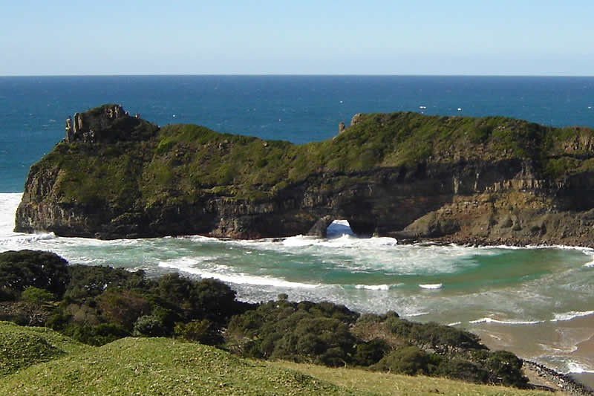

Slide 16
PROJECT TITLE/NAME | GOD’S WINDOW SKYWALK
AUTHORITY | Mpumalanga Tourism and Parks Agency (MTPA) and Motsamayi Tourism Group
LOCATION | God’s Window, Panorama Route, Thaba Chweu Local Municipality, Mpumalanga Province
TYPE OF DEVELOPMENT | Skywalk across the God’s Window with a restaurant.
PROJECT DESCRIPTION | Situated on the Drakensberg escarpment in Mpumalanga is God’s Window. With magnificent views, canyons, rock formations and waterfalls, God's Window has breathtaking scenic splendor. The development will consist a cantilevered glass suspended over the edge of a cliff, protruding about 12 metres outward. The skywalk will offer visitors a panoramic view of the lowveld with a drop of more than 900m down into the local indigenous forest-clad ravine.
APPROXIMATE COST | R500m (US$26.0m) Investment required: Investment required at 40% of the project cost - R 200m [US$10.4m]
CURRENT STATUS | Feasibility study, EIA completed and long-term lease signed.
TYPE OF PARTNERSHIPS | Debt and/or Equity Partnerships.
CONTACT DETAILS | Mr Jerry Mabena, Motsamayi Tourism Group, Cell: +27 82 784 9543& E-mail: jerry@krugershalati.com Ms Katlego Mphahlele, Senior Dealmaker: IDC, Tel: +27 11 269 3101 & Email: katlegom@idc.co.za

Slide 17
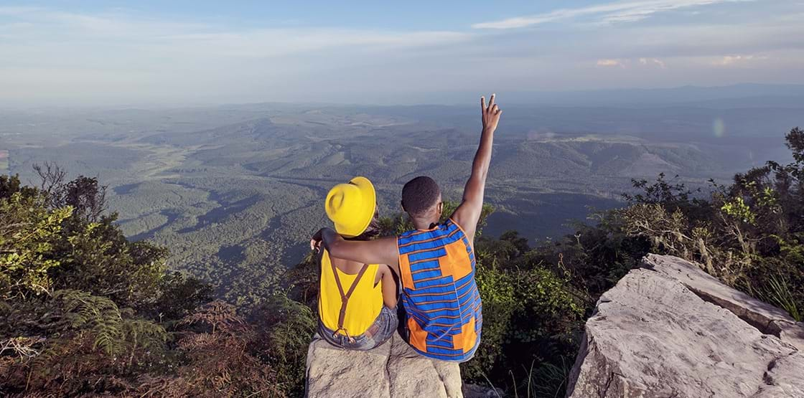
Notes:
Note: God’s Window – Current

Slide 18
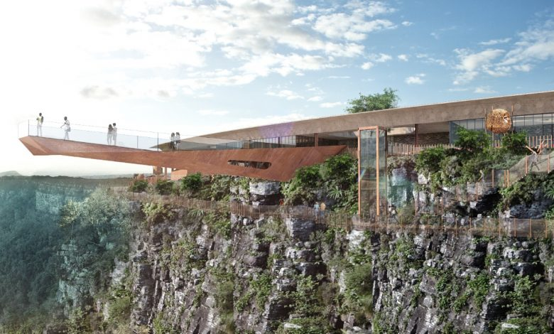

Slide 19
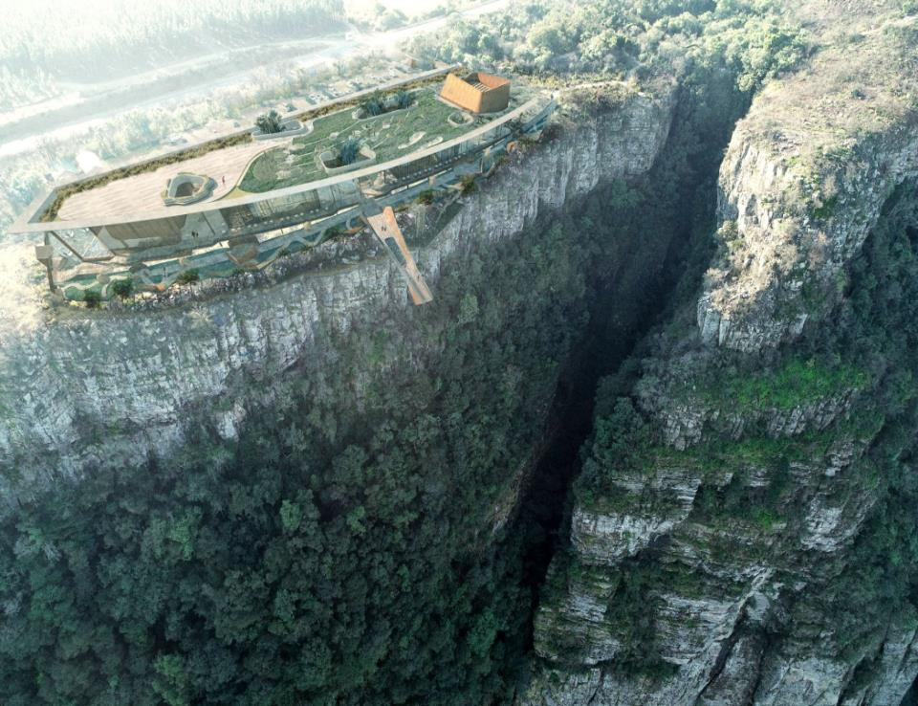

Slide 20
PROJECT TITLE/NAME | Bakubung Smart City/ Mixed-Use Development Project
AUTHORITY | Kubu Property Investment
LOCATION | Ledig, Moses Kotane Local Municipality, North West Province
TYPE OF DEVELOPMENT | Residential, retail complex, medical centre/private hospital, and hotel/lodge development Phase One: (Operator: Sondela Lifestyle Management): Luxury Tented Camp, 20 rooms as Phase one Luxury Caravan Camp x 50 sites Eco-tourism and nature conservation training college (200 students with boarding) Phase Two: Hotel/Apartments Development with minimum 100-rooms. (Looking for an operator and an equity partner)
PROJECT DESCRIPTION | Residential and Commercial Mixed-Use Development with Major Tourism Land Parcel Adjacent to the Sun City Resort and the Pilanesberg National Park (Big-5 game reserve), North West Province.
APPROXIMATE COST | ZAR3.2 billion (US$ 0.166 billion) for development of housing units, regional retail mall, lodges/hotel, private hospital, private school, library, stadium, government precinct. The costs hotel resort development estimated at ZAR1.2 billion (US$62.4m). Investment required at 40% is: R480 million (US$24.9m)
CURRENT STATUS | The project state of readiness is three-six months from commencement (Ready to take off within a year). EIAs, Rezoning, Technical Studies, Bulk Services, Master Sites Development Plans approvals are in place with market studies completed. Sondela Lifestyle Management (operating partner)
TYPE OF PARTNERSHIPS | Combination of equity, debt and government grants (community shareholding) (for 51% BOT partnership) Seeking 40% equity from the investor (US$25.4 million).
CONTACT DETAILS | Mr Jacob Ngakane, CEO: Kubu Property Investment, Mobile: +27 82 444 1764 & Email: jacob@ciholdings.co.za Ms Katlego Mphahlele, Senior Dealmaker: IDC, Tel: +27 11 269 3101 & Email: katlegom@idc.co.za

Slide 21
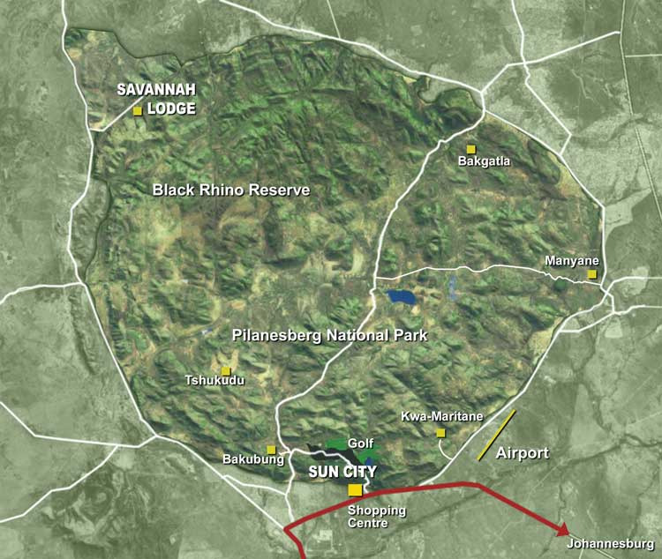

Slide 22
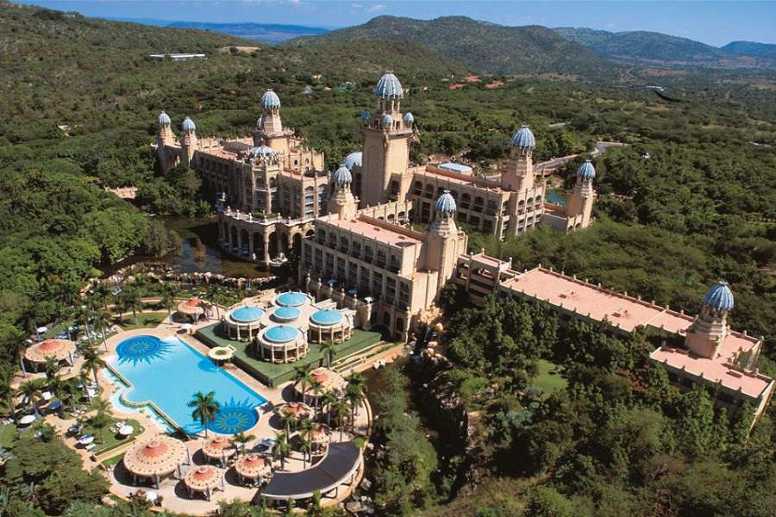
Notes:
Note: The Palace of the Lost City Hotel at Sun City Images.

Slide 24
PROJECT TITLE/NAME | ORPEN KRUGER LODGE
LOCATION | Near Orpen Gate of Kruger National Park, Bushbuckridge Local Municipality, Mpumalanga Province (And the main gate of the Manyeleti Game Reserve)
TYPE OF DEVELOPMENT | Accommodation
PROJECT DESCRIPTION | A resort with Chalets just outside the Orpen Gate of the Kruger National Park, next to Manyeleti Game Reserve. Phase 1 of the project has 10 chalets. Phase I was launched in December 2022 with the official opening graced by the Deputy Minister for Tourism. Phase II: Development of 10 additional chalets. Phase III: Development of a 144-room hotel [Phase III is a commercial venture open to debt finance from the Industrial Development Corporation and Equity from investors].
APPROXIMATE COST | Phase 1: R19m [US$0.988m] (launched in December 2022) Phase II: R15m [US$0.780m] for the development of 10 additional chalets Phase III: R95m [US$4.9m]
CURRENT STATUS | First Phase of the Lodge operational Operator has other properties in the Free State, Gauteng and the Western Cape
TYPE OF PARTNERSHIPS | Equity/Debt Partnership Grants and shares
CONTACT DETAILS | Mr Marnus Nico Coetzee, Director: MontDor Clarens Tel: 082 826 1782 Email: marnus@emssolutions.co.za

Slide 25
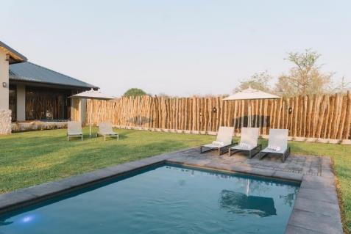
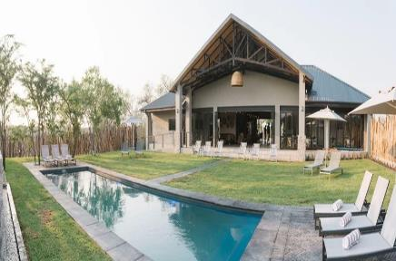
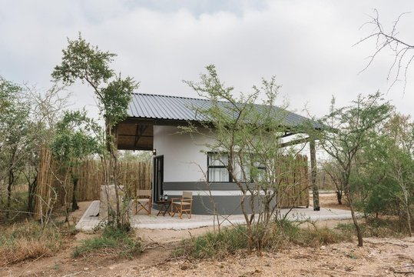
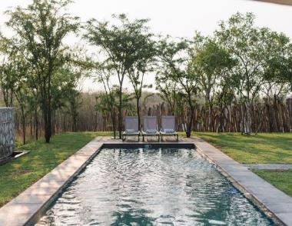

Slide 26
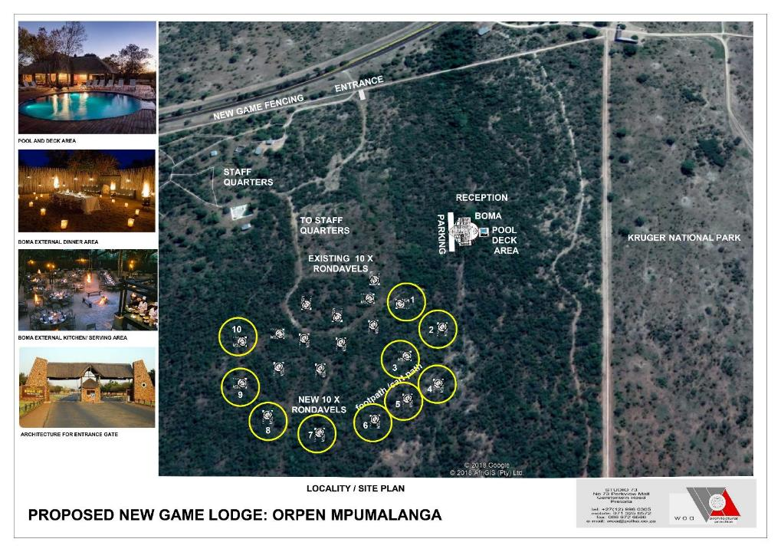

Slide 27
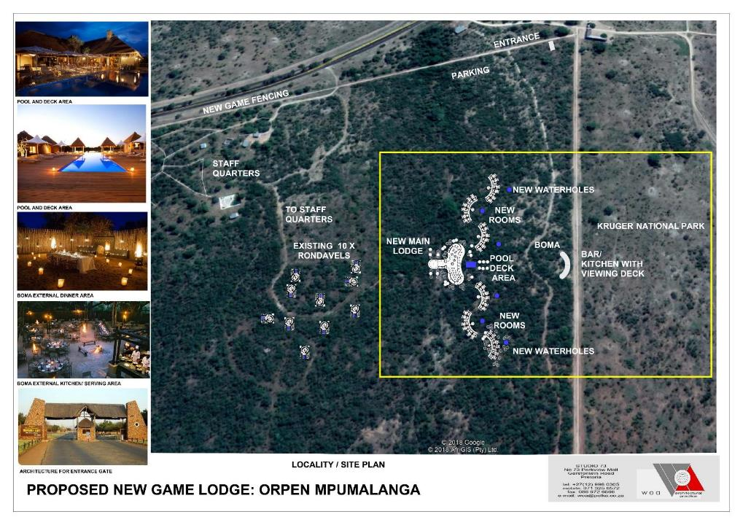

Slide 28
Foreign Investment & Taxation
Local and foreign companies are treated equally, however:
  There are local equity requirements for companies in South Africa.
  Business with non-resident ownership or local equity of less than 25% are restricted in their local borrowings. [NB]
A foreign company may establish a place of business and conduct its activities in South Africa without forming a separate locally incorporated company except in insurance and banking.
A South African (SA)-resident company is subject to corporate income tax (CIT) on its worldwide income, irrespective of the source of the income. Non-residents are taxable on SA-source income.
In South Africa, the Corporate Income Tax (CIT) rate applicable for corporate income of both resident and non-resident companies at a flat rate of 27%.
Notes:
NB: Deloitte, 2017, Taxation and Investment in South Africa 2017 (Updated in October 2017), page 4. The sentence was revised from “…control of at least 75% are restricted in their local borrowings. On top of the borrowing advantages, we need a crafting that will indicate the advantages of embracing B-BBEE or the Tourism B-BBEE Charter to be precise when engaging international investors, i.e. to make it attractive, indicating benefits of complying with the Charter.

Slide 29
What we do
Selected Investment Incentives (1)
Green Tourism Incentive Programme managed by the Industrial Development Corporation (IDC):
  Managed by the Industrial Development Corporation
  Tourism Incentives on a sliding scale between 50% to 90% of total cost of approved energy and water efficiency solution, capped at R1m (US$0.054)
Tourism Transformation Fund managed by the National Empowerment Fund (NEF):
  The grant component is capped at 50% of the total funding required up to a maximum of R 5m (US$0.26m) per project. Could be accessed by local equity partners.
  Critical Infrastructure Programme managed by the Department of Trade, Industry and Competition (the dtic):
  Grant of betw. 10%-30% of total qualifying infrastructural development costs, capped at R50 million (US$ 2.6 million). 10%-50% for agro-processing and projects alleviating water and/or electricity dependency on national grid.
  Municipal Infrastructure Grant managed by the Department of Cooperative Governance (DCoG):
  Funds can be made available for municipal airports, roads, day care centre, sports facilities, etc. as long as the infrastructure is used extensively by the poor.

Slide 30
What we do
Selected Investment Incentives (2)
Capital Projects Feasibility Programme managed by the dtic:
  For capital projects outside South Africa.
  It is a conditional cost-sharing grant.
  The grant is capped at R8m [US$0.416m] to a maximum of 50% of the total costs of the feasibility study for projects outside Africa and 55% of the total costs of the feasibility study for projects on the African continent.

Slide 31
THANK
YOU!

